Slide 1

Climate change, water management, and the Colorado River basin
Julie Vano (NCAR)
Collaborators on synthesis paper: Dennis Lettenmaier (UW, CIG), Brad Udall (WWA) , Dan Cayan, Tapash Das, Hugo Hidalgo (CAP), Jonathan Overpeck, Holly Hartmann, Kiyomi Morino (CLIMAS), Robin Webb, Marty Hoerling (NOAA), Greg McCabe (USGS), Levi Brekke (Reclamation), Kevin Werner (NWS RFC)
Collaborators on ongoing research: Martyn Clark, Andy Wood, Ethan Gutmann, Andy Newman, Naoki Mizukami, Keith Musselman, Nans Addor, Pablo Mendoza, Joe Hamman (NCAR), Jeff Arnold (USACE), Ken Nowak, Levi Brekke (Reclamation), Bart Nijssen, Elizabeth Clark (University of Washington)
www.fs.usda.gov
CEE 578 Water management and planning
Seattle, Washington, May 30, 2017

Slide 2
Climate change in water management

Slide 3
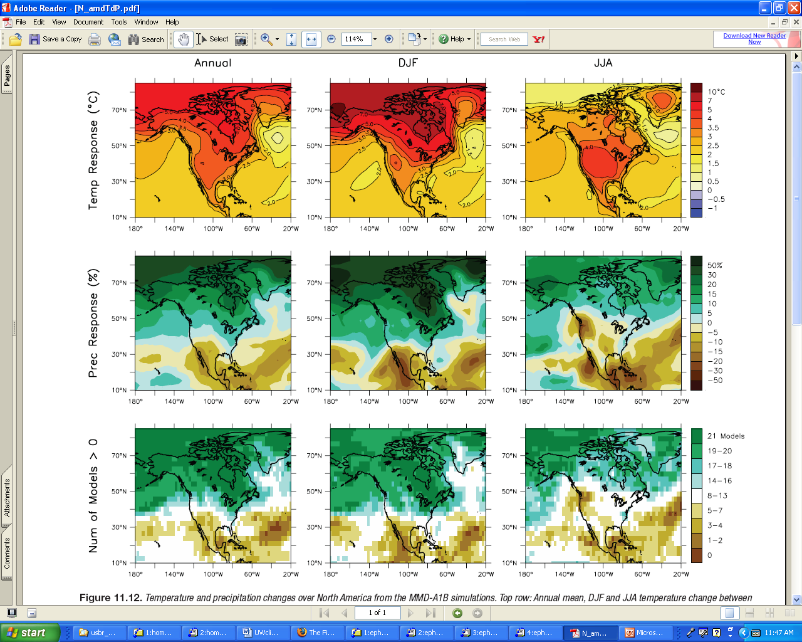
Intergovernmental Panel on Climate Change (IPCC) 2007
Annual
Annual
What are trends for local watersheds?
AND, how does this relate to streamflow?
Consensus Forecasts of Temperature and Precipitation Changes from IPCC AR4 GCMs (changes between 1980 to 1999 and 2080 to 2099, averaged over 21 models for A1B)
Notes:
http://www.ipcc.ch/publications_and_data/ar4/wg1/en/ch11s11-5-3-2.html
Figure 11.12. Temperature and precipitation changes over North America from the MMD-A1B simulations. Top row: Annual mean, DJF and JJA temperature change between 1980 to 1999 and 2080 to 2099, averaged over 21 models. Middle row: same as top, but for fractional change in precipitation. Bottom row: number of models out of 21 that project increases in precipitation.

Slide 4
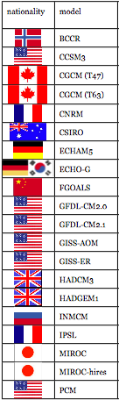
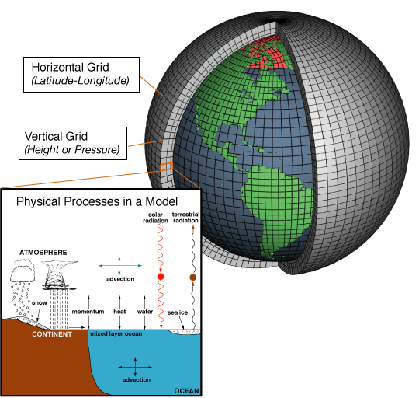
Global Climate Models (GCMs) also known as General Circulation Models
Systems of differential equations based on the basic laws of physics, fluid motion, and chemistry. Atmospheric models calculate winds, heat transfer, radiation, relative humidity, and surface hydrology within each grid and evaluate interactions with neighboring points.
Figures from Mote et al. (2008) and http://celebrating200years.noaa.gov/breakthroughs/climate_model/modeling_schematic.html
Notes:
http://celebrating200years.noaa.gov/breakthroughs/climate_model/modeling_schematic.html
Climate models are systems of differential equations based on the basic laws of physics, fluid motion, and chemistry. To "run" a model, scientists divide the planet into a 3-dimensional grid, apply the basic equations, and evaluate the results. Atmospheric models calculate winds, heat transfer, radiation, relative humidity, and surface hydrology within each grid and evaluate interactions with neighboring points.

Slide 5
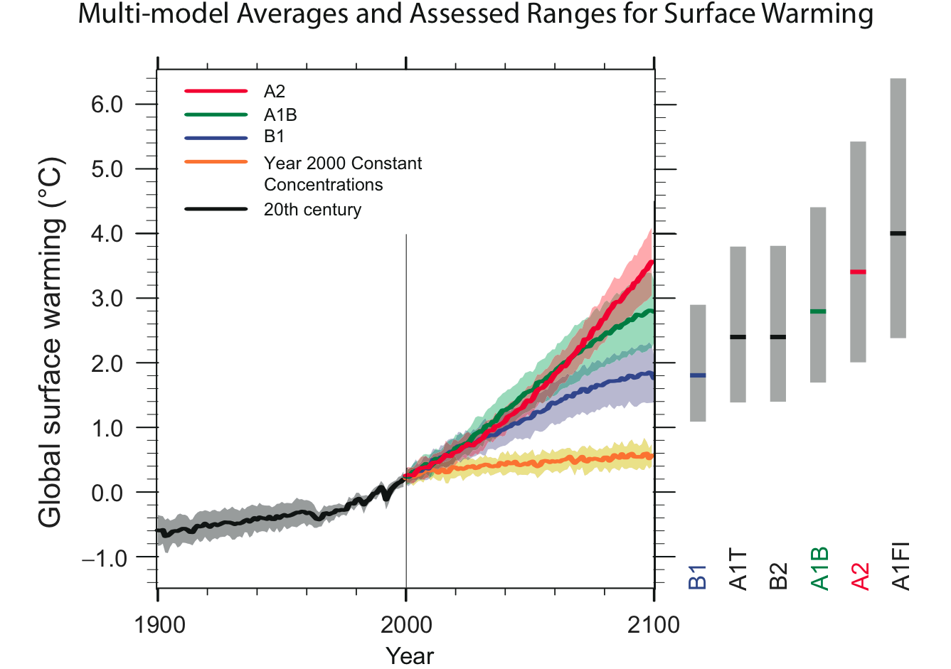
Greenhouse Gas Emission Scenarios
A2: Self reliance and preservation of local identities, continued population growth, regional development where technological development is slower than other scenarios.
A1B: Rapid economic growth, population declines after mid-century, balance of energy sources (both fossil and non-fossil fuel intensive).
B1: Population declines after mid-century, develop clean and resource efficient technologies, global cooperation.
Figure from IPPC report, 2007; ©IPCC 2007: WG1-AR4
Notes:
four most important greenhouse gases-carbon dioxide, methane, nitrous oxide, and fluorinated gases
FIGURE SPM-5. Solid lines are multi-model global averages of surface warming (relative to 1980-99) for the scenarios
A2, A1B and B1, shown as continuations of the 20th century simulations. Shading denotes the plus/minus one standard
deviation range of individual model annual averages. The orange line is for the experiment where concentrations were
held constant at year 2000 values. The gray bars at right indicate the best estimate (solid line within each bar) and the
likely range assessed for the six SRES marker scenarios. The assessment of the best estimate and likely ranges in the gray
bars includes the AOGCMs in the left part of the figure, as well as results from a hierarchy of independent models and
observational constraints. {Figures 10.4 and 10.29}
The Emission Scenarios of the IPCC Special Report on Emission Scenarios (SRES)17
A1. The A1 storyline and scenario family describes a future world of very rapid economic growth, global population
that peaks in mid-century and declines thereafter, and the rapid introduction of new and more efficient technologies.
Major underlying themes are convergence among regions, capacity building and increased cultural and social
interactions, with a substantial reduction in regional differences in per capita income. The A1 scenario family develops
into three groups that describe alternative directions of technological change in the energy system. The three A1 groups
are distinguished by their technological emphasis: fossil intensive (A1FI), non-fossil energy sources (A1T), or a
balance across all sources (A1B) (where balanced is defined as not relying too heavily on one particular energy source,
on the assumption that similar improvement rates apply to all energy supply and end use technologies).
A2. The A2 storyline and scenario family describes a very heterogeneous world. The underlying theme is self reliance
and preservation of local identities. Fertility patterns across regions converge very slowly, which results in
continuously increasing population. Economic development is primarily regionally oriented and per capita economic
growth and technological change more fragmented and slower than other storylines.
B1. The B1 storyline and scenario family describes a convergent world with the same global population, that peaks in
mid-century and declines thereafter, as in the A1 storyline, but with rapid change in economic structures toward a
service and information economy, with reductions in material intensity and the introduction of clean and resource
efficient technologies. The emphasis is on global solutions to economic, social and environmental sustainability,
including improved equity, but without additional climate initiatives.
B2. The B2 storyline and scenario family describes a world in which the emphasis is on local solutions to economic,
social and environmental sustainability. It is a world with continuously increasing global population, at a rate lower
than A2, intermediate levels of economic development, and less rapid and more diverse technological change than in
the B1 and A1 storylines. While the scenario is also oriented towards environmental protection and social equity, it
focuses on local and regional levels.
An illustrative scenario was chosen for each of the six scenario groups A1B, A1FI, A1T, A2, B1 and B2. All should be
considered equally sound.

Slide 6
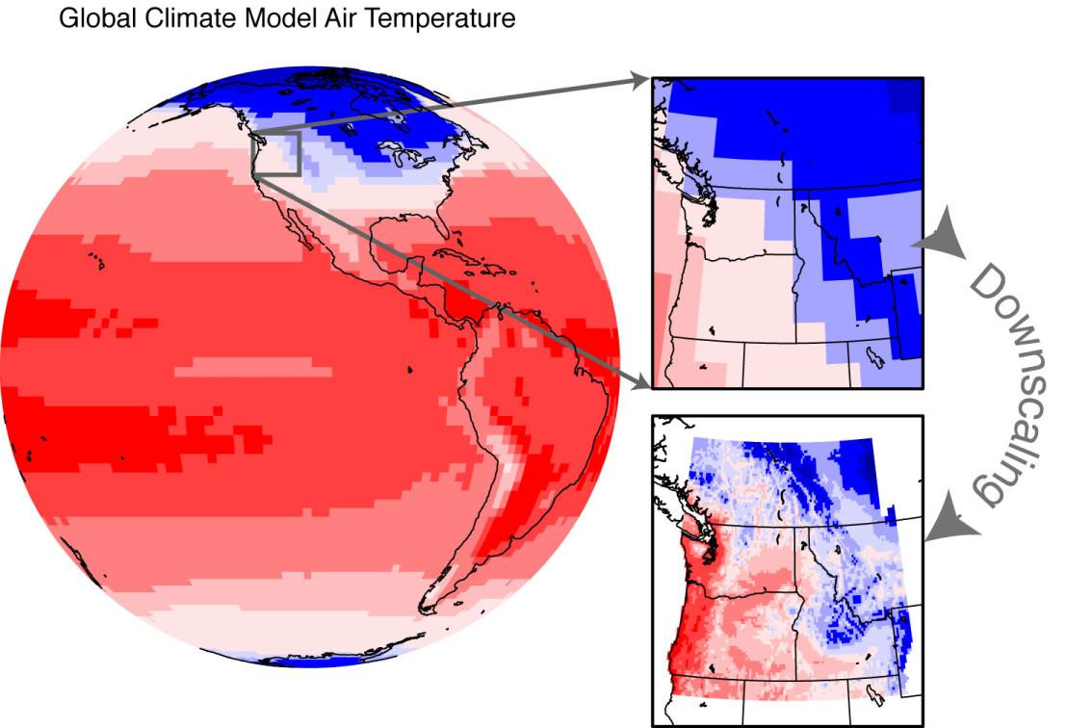
Climate model downscaling
How do we translate global info into regional water management?
Figure courtesy of Climate Impacts Group
Notes:
The 4th source of uncertainty, how global information is translated into regional water management. In other words, the methods used to downscale from the roughly 200-kilometer resolution used by global climate models to the 10- to 20-kilometer resolution used by regional hydrology models)

Slide 7
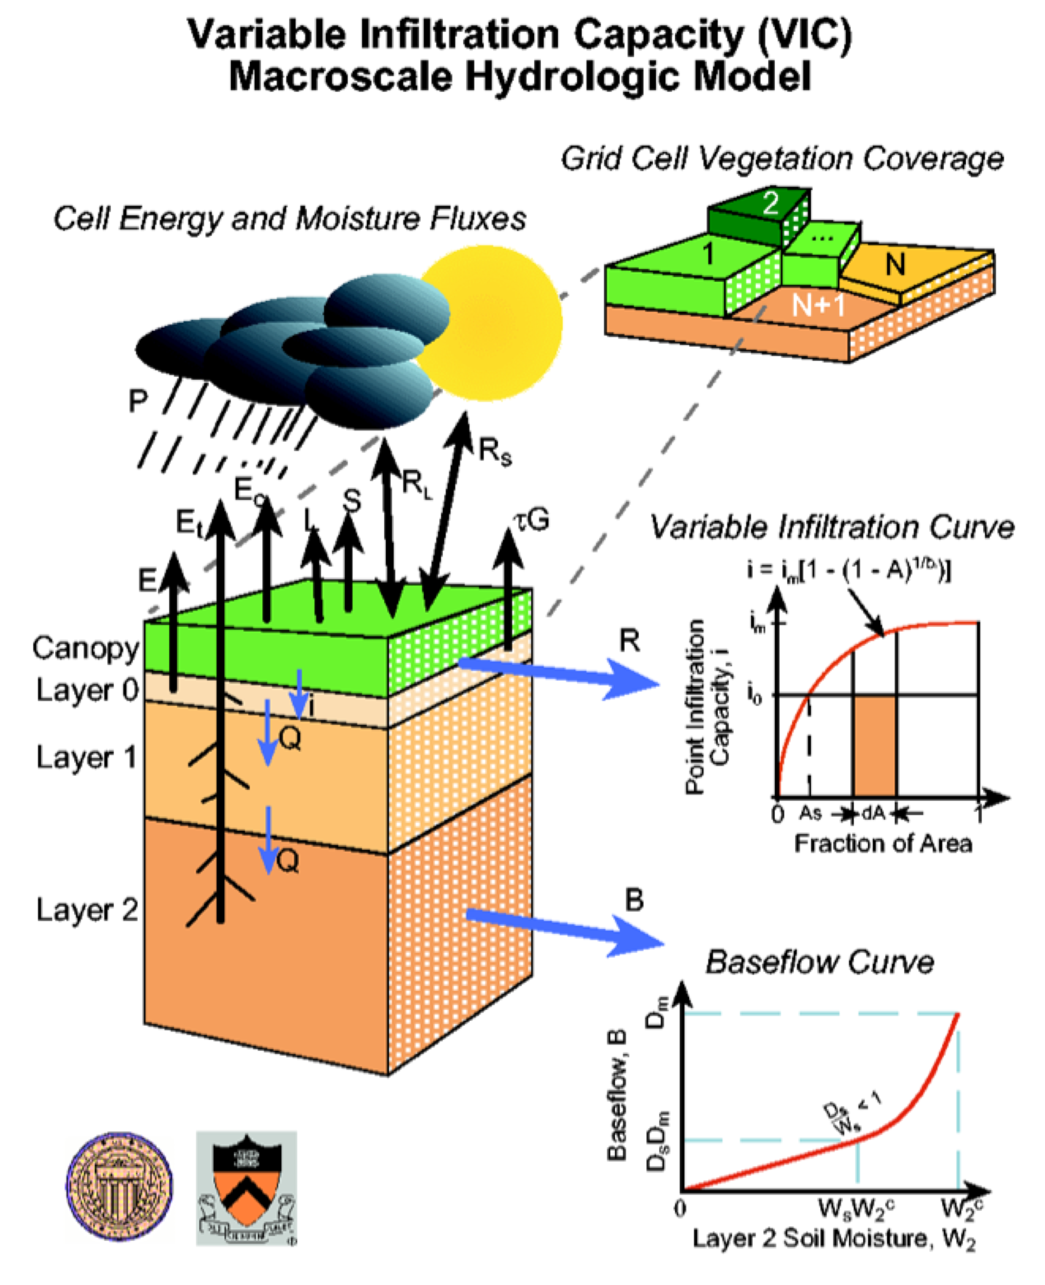
Hydrologic modeling
Grid-based simulations of land-surface processes using principles of energy and water balance
Daily timesteps with some sub-daily processes
Forcing data: precipitation, temperature, specific humidity, wind speed, air pressure, and surface incident shortwave and longwave

Slide 8
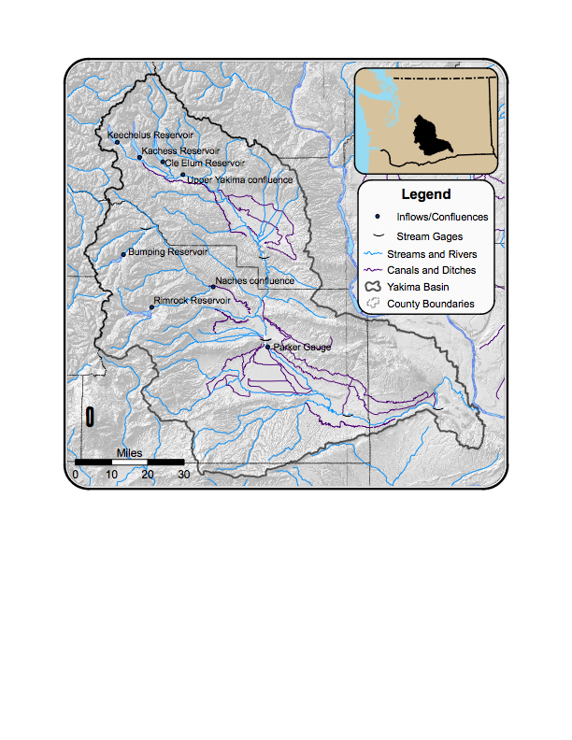
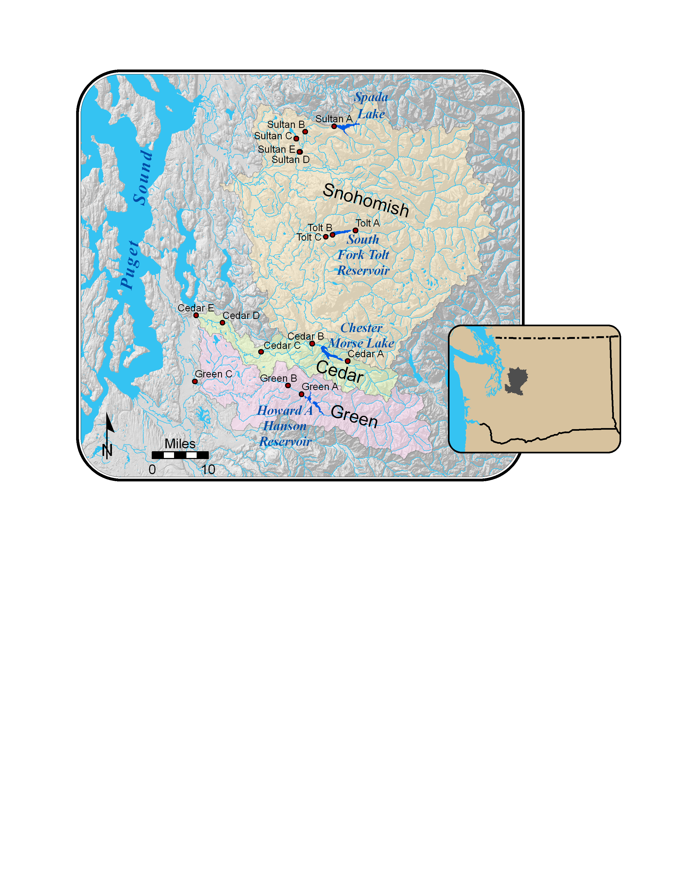
Washington State Climate Change Impacts Assessment
x
Water mgmt case study 1:
Yakima R basin
irrigated agriculture
Water mgmt case study 2:
Puget Sound basin
municipal
Collaborators: Nathalie Voisin (UW) , Michael Scott (PNNL), Lan Cuo (UW) , Marketa McGuire Elsner (CIG) , Alan Hamlet (CIG), Kristian Mickelson (USACE), Richard Palmer (UMass), Austin Polebitski (UMass), Claudio Stockle (WSU) , and Dennis Lettenmaier (UW)

Slide 9
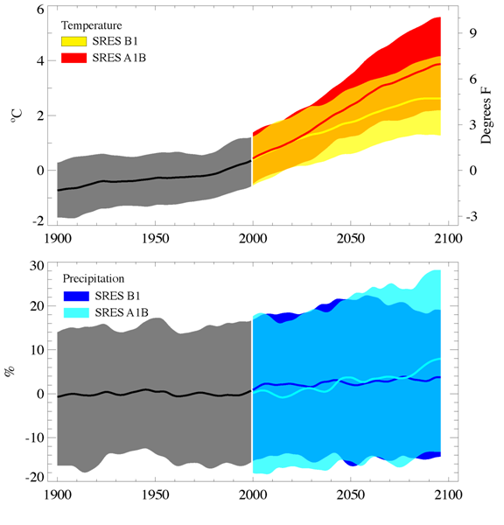
Projected Changes in Annual Temperature and Precipitation
°C
°F
* Compared with 1970-1999 average
Notes:
9
Figure 3. Simulated temperature (change, top panel) and precipitation (% change, bottom panel) for the 20th and 21st Century climate model simulations. The black curve for each panel is the weighted average of all models during the 20th Century. The colored areas indicate the range (5th to 95th percentile) for each year in the 21st Century. All changes are relative to 1970-1999 averages.

Slide 10
Method for making global information relevant to local scales
Global Climate
Model (P_{GCM},T_{GCM})
bias correcting,
downscaling
Delta method downscaling:
2020s, 20 A1B, 19 B1
2020s composite
2040s composite
2080s composite

Slide 11
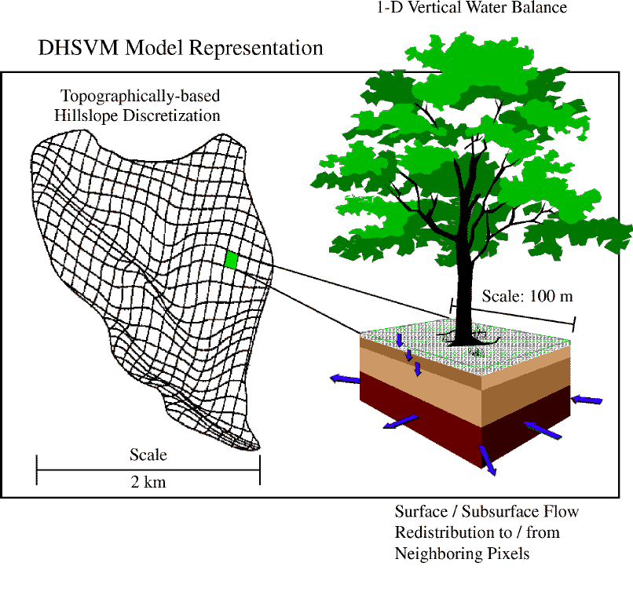
Method for making global information relevant to local scales
Global Climate
Model (P_{GCM},T_{GCM})
bias correcting,
downscaling
Hydrology
Models
stream routing,
bias correcting

Slide 12
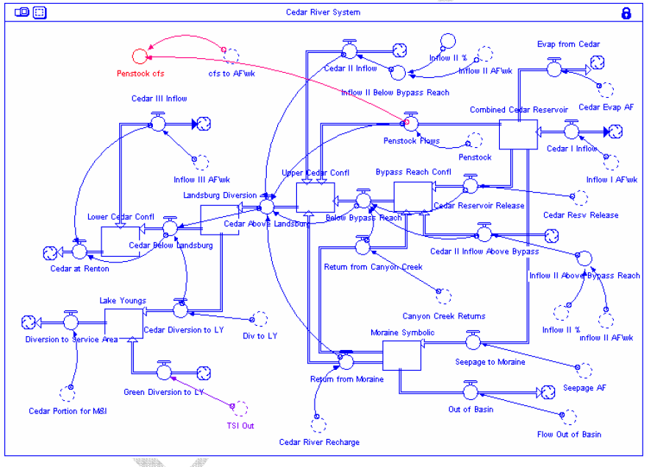
Method for making global information relevant to local scales
Global Climate
Model (P_{GCM},T_{GCM})
bias correcting,
downscaling
Hydrology
Models
stream routing,
bias correcting
Future
streamflow

Slide 13
Case study 1: Yakima River Basin
Irrigated crops largest agriculture value in the state
Precipitation (fall-winter), growing season (spring-summer)
Five USBR reservoirs with storage capacity of ~1 million acre-ft, ~30% unregulated annual runoff
Snowpack sixth reservoir
Water-short years impact water entitlements
Notes:
Elevation 8184 ft to 340 ft
Historic Temp and precip
22°-76°F, 80 in-140 in at 2300 ft, 27°-90°F, 0 in-10 in at 350 ft
61% -81% precip in October-March
This water is used in many ways…
-TWSA: multiple regression analysis uses correlations with precipitation, streamflow, snow measures, forecasts are made for precipitation levels of 50, 100 and %150 normal.
Elevation 8184 ft to 340 ft
Historic Temp and precip
22°-76°F, 80 in-140 in at 2300 ft, 27°-90°F, 0 in-10 in at 350 ft
61% -81% precip in October-March
Water supply during growing season in lower basin primarily from snowmelt, depends on reservoirs for storage
Six USBR reservoirs with storage capacity of ~1 million acre-ft, ~25% unregulated runoff
Managed system vulnerable to drought with increasing water use and changing snowpack
DETAILS ON TWSA:
Max, Min, and Avg all from 1981-2000 and 2007 values of:
(1) System Unregulated Flow Volume (system of reservoirs, sum of inflows),
(2) Observed Flow Volume (system of reservoirs, sum of outflows),
(3) Parker Unregulated Flow Volume (Yakima River NR Parker mean daily natural discharge),
(4) Parker Observed Flow Volume (Yakima River NR Parker mean daily regulated discharge)
(5) Yakima System Diversions (5 major irrigation diversions above Parker)
(6) Yakima System Storage (Reservoir system storage, mean daily reservoir volume)
REFERENCES:
(USBR, 2002)
http://www.wrcc.dri.edu/cgi-bin/cliMAIN.pl?wa4154: KENNEWICK, WASHINGTON (454154)
http://www.wrcc.dri.edu/cgi-bin/cliMAIN.pl?wa4406: LAKE KACHESS, WASHINGTON (454406)
Precipitation varies considerably across the basin throughout the year. Mean-annual precipitation ranges from 140 inches in the higher mountains of the northwestern part of the basin to less than 10 inches throughout the lower Yakima Valley. The amount of precipitation that occurs during the period of Oct ober to March period, both the arid and alpine parts of the basin ranges from 61-81% of the annual precipitation. The variation in annual precipitation can be large. The geographic variability of mean annual precip 1951-1980 in high mts between 80-140 inches in lower between 0-10 inches (USBR 2002, pg 2-2)
Water quality, generally high in upper basin. Degrades downstream. Many reaches in Federal Clean Water Act 303(d) list. Issues of turbidity, pesticides, low dissolved oxygen, elevated temperatures, metals, fecal coliform, low flows, and pH.
Air temps, inversely related to altitude. Min and Max occur in Jan and July. Values above from LAKE KACHESS (1971-2000 Monthly Climate Summary, Average Min in Jan and Average Max in July)
-Reserviors been in place since 1930s
-Irrigation project serves 465,000 acres
-Basin drains about 4 million acres (Basin drains about 6150 sq miles)
-Yakima River flows about 215 miles
-Estimated unregulated runoff of Yakima Basin (1961-1990) is 3.97 million acre-ft
FROM POSTER, AGU 2006
-The USBR Yakima Project supports approximately 464,000 irrigated acres (via four irrigation districts -- Roza, Yakima-Tieton, Sunnyside Valley and Kittitas -- and the Wapato Division).
-Most of the water in the Yakima River comes from snowmelt, and is caught in a series of reservoirs to ensure sufficient water supply throughout the season.

Slide 14
Key Findings in Yakima Basin
Historical
2020s
2020s range
2040s
2080s
2080s
Historical
Primary impacts of climate change will be a shift on average in the timing of peak river flow from late spring to winter

Slide 15
Key Findings in Yakima Basin
Historical
2020s
2020s range
2040s
2080s
2080s
Historical
Primary impacts of climate change will be a shift on average in the timing of peak river flow from late spring to winter
Because of shift in timing, future projections indicated reservoir system will be less able to supply water to all users, especially those with junior water rights
Water prorationing levels which damage crops (A1B)

Slide 16
Case study 2: Puget Sound Basin
Precipitation in fall-winter, water demand in summer
Water management systems:
Seattle - municipal, fish
Tacoma - municipal, flood control
Everett - municipal, hydropower
Reservoir capacities small relative to annual flow

Slide 17
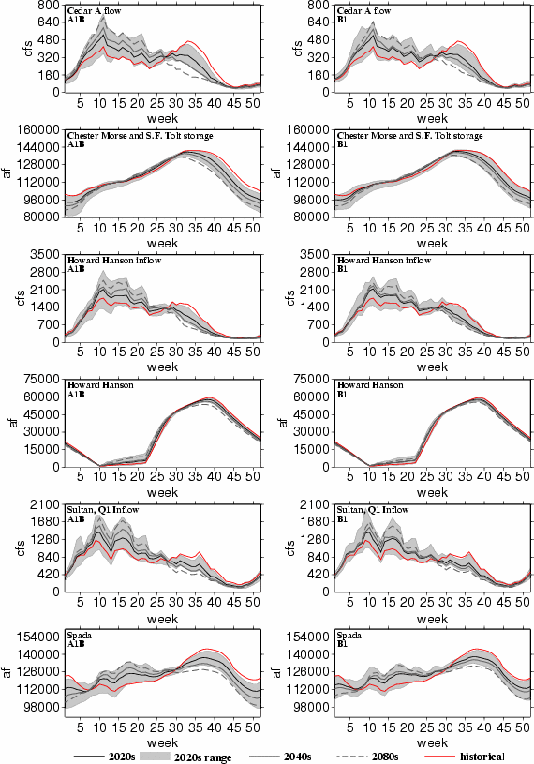
Key Findings in Puget Sound
Historical
2020s
2020s range
2040s
2080s
Again, primary impacts of climate change will be a shift on average in the timing of river flow from late spring to winter
Notes:
With current demands, systems accommodate changes, with demand increases, systems less able to accommodate changes from future climate, conservation measures matter
Other aspects of system performance complicate management decisions such as environmental flows, flood control, and hydropower

Slide 18
Key Findings in Puget Sound
Historical
2020s
2020s range
2040s
2080s
Again, primary impacts of climate change will be a shift on average in the timing of river flow from late spring to winter
With current demands, water systems accommodate changes
1%
5%
23%
36%
Notes:
With current demands, systems accommodate changes, with demand increases, systems less able to accommodate changes from future climate, conservation measures matter
Other aspects of system performance complicate management decisions such as environmental flows, flood control, and hydropower

Slide 19
Key Findings in Puget Sound
Historical
2020s
2020s range
2040s
2080s
Again, primary impacts of climate change will be a shift on average in the timing of river flow from late spring to winter
With current demands, water systems accommodate changes; with demand increases, systems less able to accommodate changes
1%
5%
23%
36%
Notes:
With current demands, systems accommodate changes, with demand increases, systems less able to accommodate changes from future climate, conservation measures matter
Other aspects of system performance complicate management decisions such as environmental flows, flood control, and hydropower

Slide 20
Key Findings in Puget Sound
Historical
2020s
2020s range
2040s
2080s
Again, primary impacts of climate change will be a shift on average in the timing of river flow from late spring to winter
With current demands, water systems accommodate changes; with demand increases, systems less able to accommodate changes
Other aspects of system performance also effected (e.g., environmental flows, flood control, hydropower).
Notes:
With current demands, systems accommodate changes, with demand increases, systems less able to accommodate changes from future climate, conservation measures matter
Other aspects of system performance complicate management decisions such as environmental flows, flood control, and hydropower

Slide 21
Colorado River basin

Slide 22
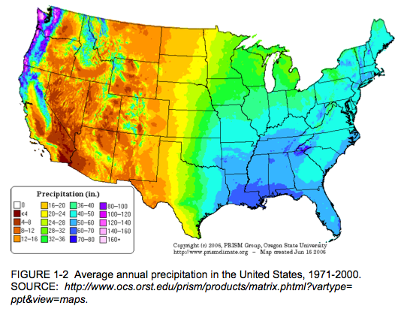
Figure from NRC report on Colorado River Basin Water, 2007

Slide 23
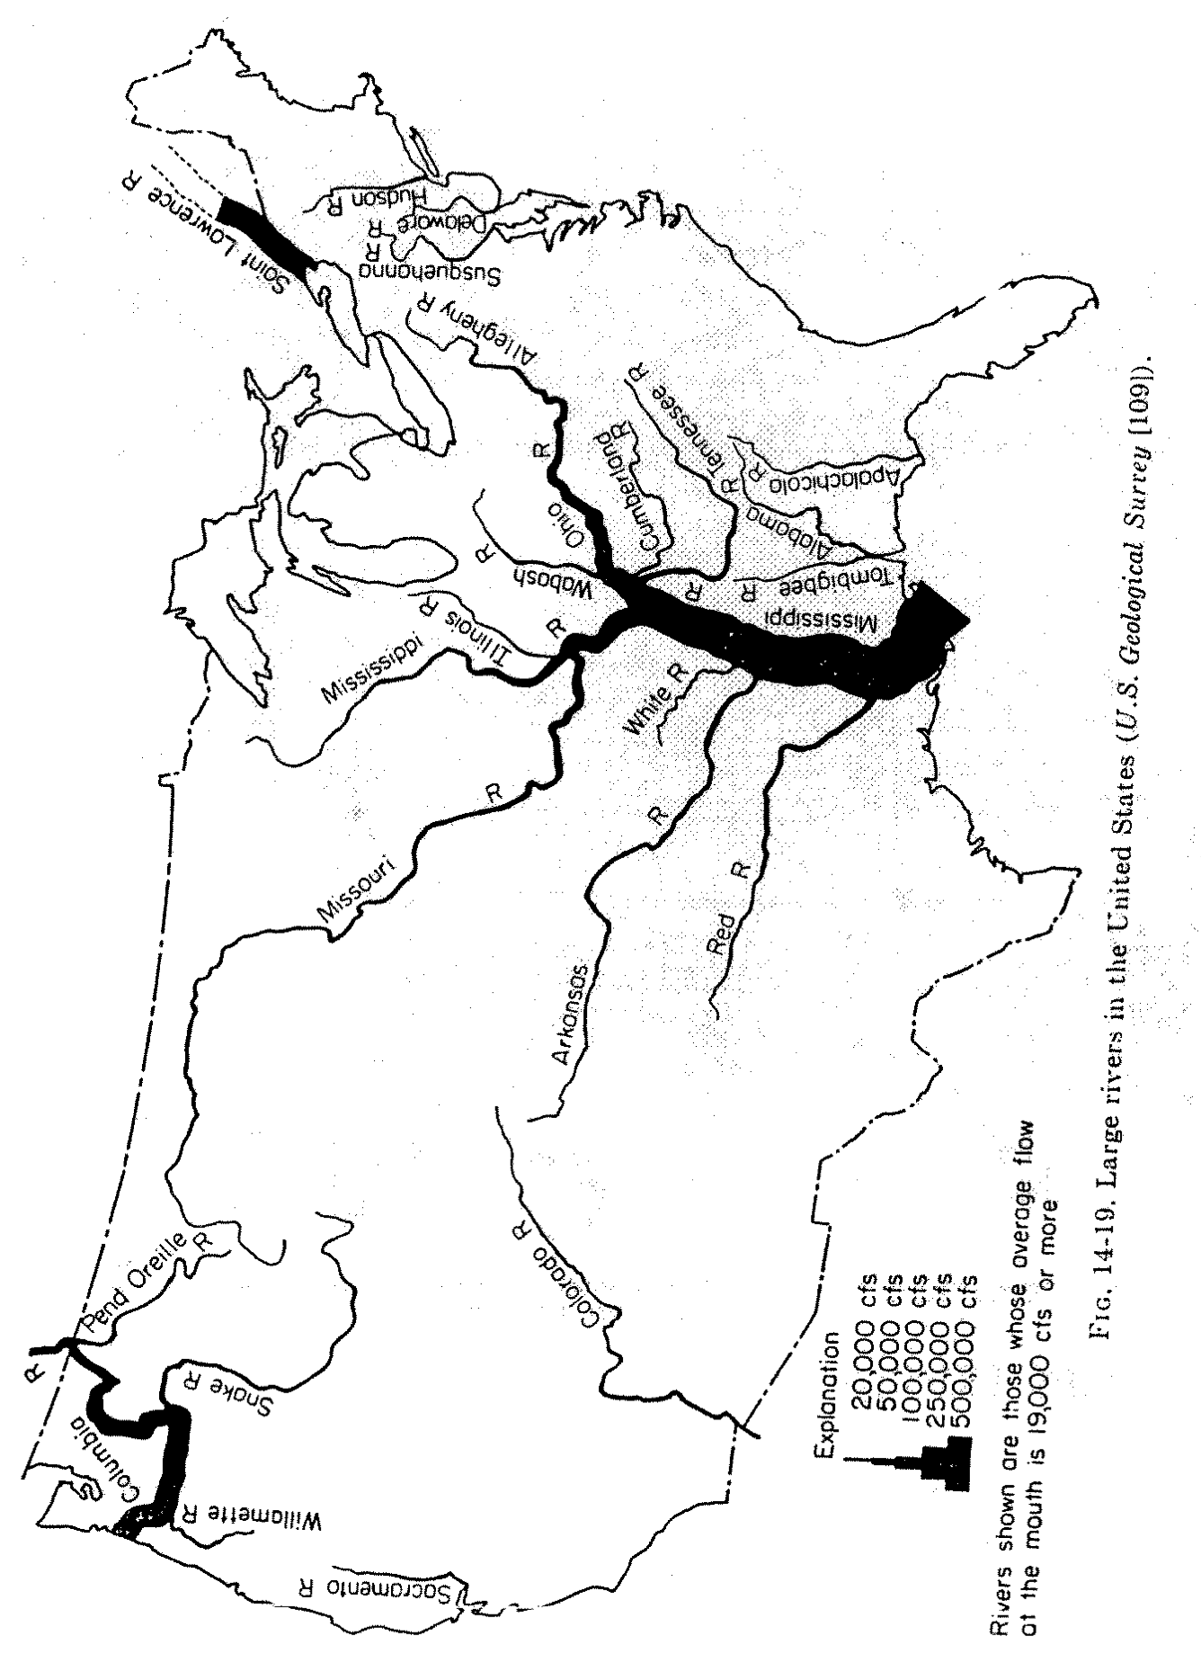
0.3
4
total storage relative to annual inflow ratios
Figure from Steve Burges, CEE 576, Physical Hydrology, Fall 2007

Slide 24
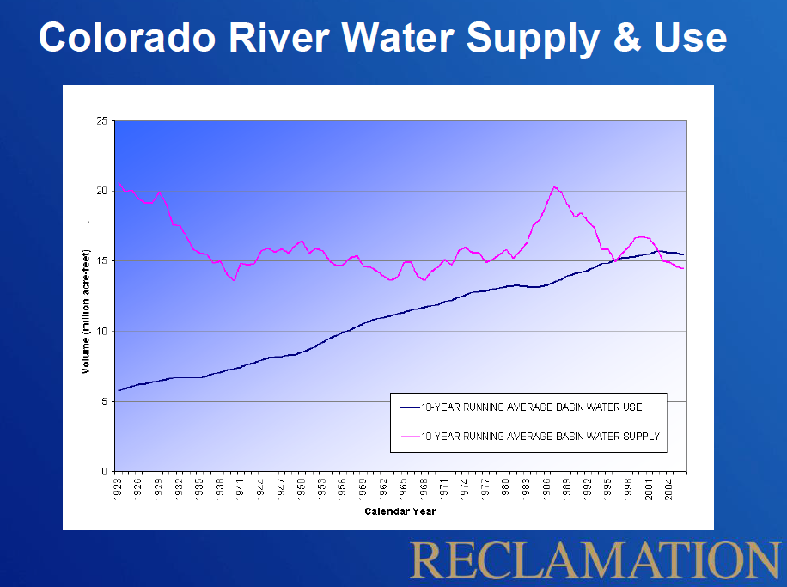
Volume (million acre-feet)
10-YR RUNNING AVG WATER USE
10-YR RUNNING AVG WATER SUPPLY
Calendar Year
Slide from Terry Fulp’s presentation, Collaborative Workshop Series, Arizona State Univ., April 2, 2010

Slide 25
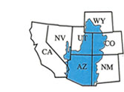
Naturalized Flow at Lees Ferry, AZ
Flow measurements for the Colorado River Compact 1922
allocated 20.4 BCM
(16.5 MAF)
Annual Flow (BCM)
currently used
16.3 BCM
(13.2 MAF)
Annual Flow 10-Year Running Mean Running Mean
Figure adapted from Christensen et al., 2004; data from the U.S. Bureau of Reclamation.

Slide 26
Paleoclimate Records
80% confidence
intervals
25-year running averages, instrumental record
25-year running averages, streamflow reconstruction
Allocated flows, 20.4 BCM (16.5 MAF)
10 most persistent droughts in PDSI record, from Table 1 in Routson et al.’s (2011)
Observed values from USBR
Figure from Vano et al., BAMS, 2014; 1250-year streamflow construction data as reported by Meko et al. (GRL, 2007) and 2000-year North America summer PDSI reconstruction version 2a from Cook et al. (2008) as reported by Routson et al. (GRL, 2011)
Notes:
Meko, D.M., et al. 2007b. Upper Colorado River Flow Reconstruction. IGBP PAGES/World Data Center for Paleoclimatology Data Contribution Series # 2007-052. NOAA/NCDC Paleoclimatology Program, Boulder CO, USA.

Slide 27
Paleoclimate Records
80% confidence
intervals
25-year running averages, instrumental record
25-year running averages, streamflow reconstruction
Allocated flows, 20.4 BCM (16.5 MAF)
10 most persistent droughts in PDSI record, from Table 1 in Routson et al.’s (2011)
Observed values from USBR
Figure from Vano et al., BAMS, 2014; 1250-year streamflow construction data as reported by Meko et al. (GRL, 2007) and 2000-year North America summer PDSI reconstruction version 2a from Cook et al. (2008) as reported by Routson et al. (GRL, 2011)
Notes:
Meko, D.M., et al. 2007b. Upper Colorado River Flow Reconstruction. IGBP PAGES/World Data Center for Paleoclimatology Data Contribution Series # 2007-052. NOAA/NCDC Paleoclimatology Program, Boulder CO, USA.

Slide 28
Paleoclimate Records
80% confidence
intervals
25-year running averages, instrumental record
25-year running averages, streamflow reconstruction
Allocated flows, 20.4 BCM (16.5 MAF)
10 most persistent droughts in PDSI record, from Table 1 in Routson et al.’s (2011)
Observed values from USBR
Figure from Vano et al., BAMS, 2014; 1250-year streamflow construction data as reported by Meko et al. (GRL, 2007) and 2000-year North America summer PDSI reconstruction version 2a from Cook et al. (2008) as reported by Routson et al. (GRL, 2011)
Notes:
Meko, D.M., et al. 2007b. Upper Colorado River Flow Reconstruction. IGBP PAGES/World Data Center for Paleoclimatology Data Contribution Series # 2007-052. NOAA/NCDC Paleoclimatology Program, Boulder CO, USA.

Slide 29
Climate exercise case study

Slide 30
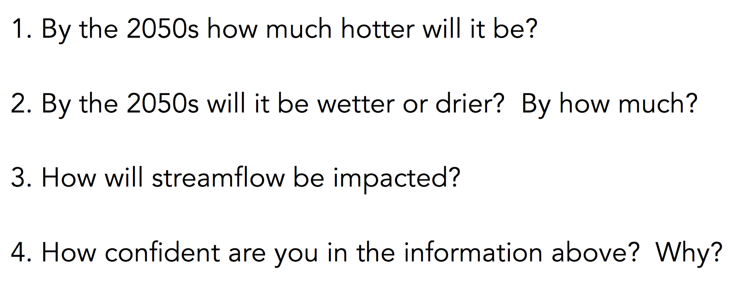
Projected Climate Change

Slide 31
Climate Data Online
Group 1 (last names A-K)
http://www.climatewizard.org
https://www.esrl.noaa.gov/psd/ipcc/
https://www2.usgs.gov/climate_landuse/clu_rd/nccv.asp
http://maca.northwestknowledge.net/tool_summarymaps2.php
Group 2 (last name L-Z)
http://gdo-dcp.ucllnl.org
https://toolkit.climate.gov/climate-explorer2
http://climexp.knmi.nl/plot_atlas_form.py
https://gisclimatechange.ucar.edu/inspector

Slide 32
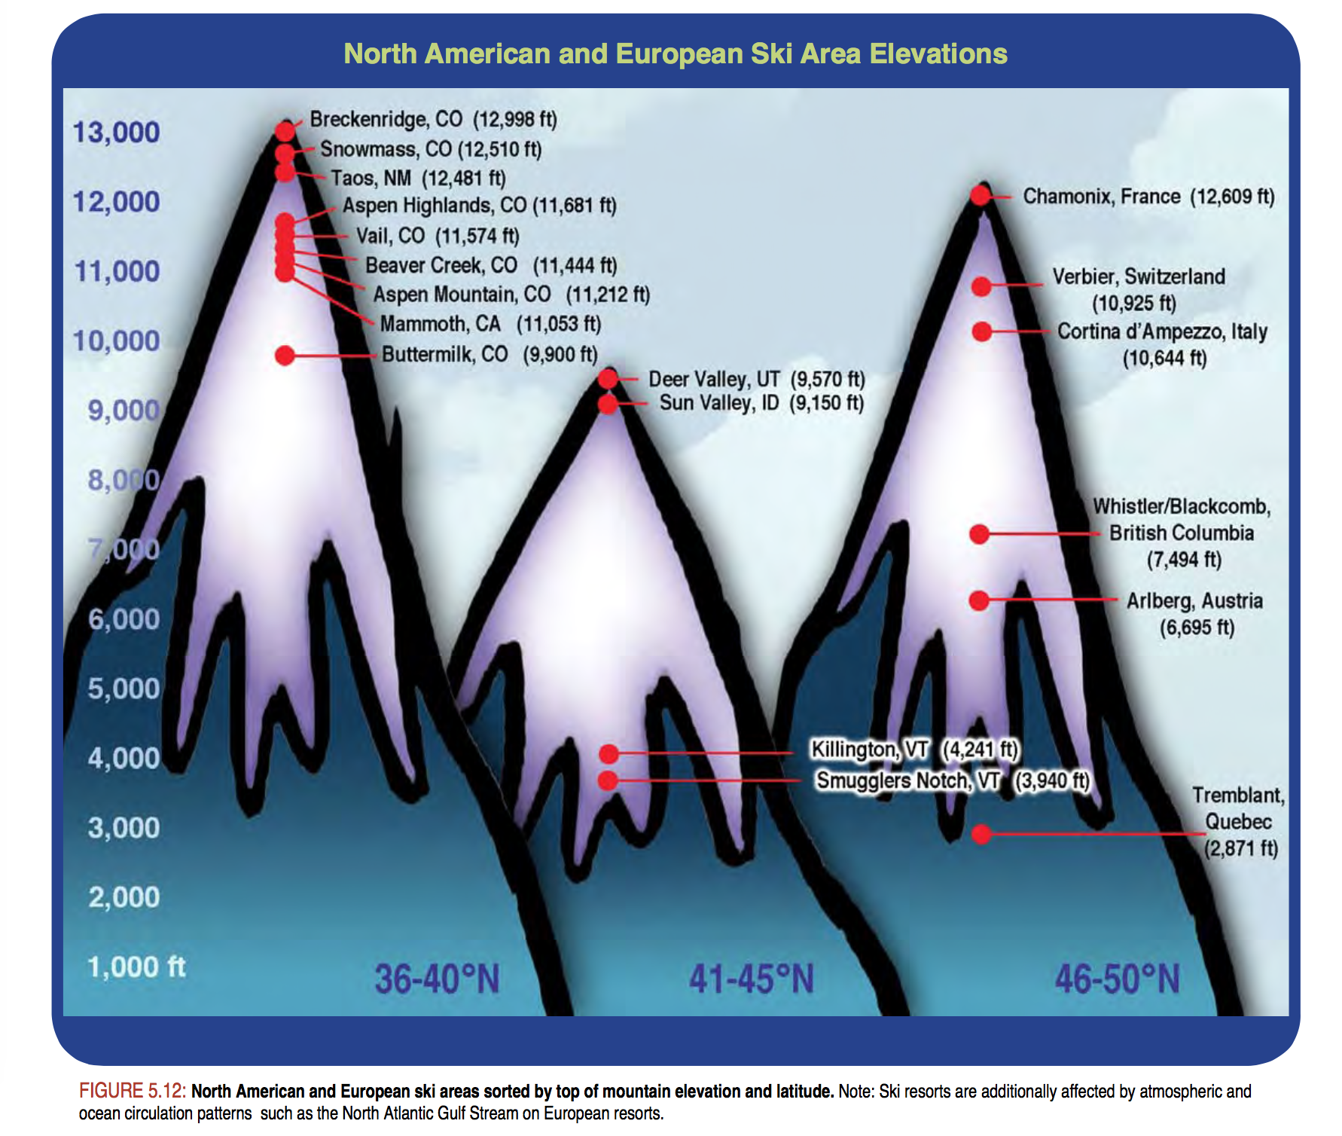
Reporting top elevation.
In Washington: Mt. Baker 5,089 ft; Snoqualmie 5,420 ft (Alpental); Crystal 7,012 ft; Stevens Pass 5,845 ft
Notes:
Snoqualmie: Top elevation: 5,420 ft (1,652 m) (Alpental)
Base elevation: 2,610 ft (796 m); (Summit East)
Crystal
7,012 ft (2,137 m), 3,912 ft (1,192 m)
Mt. Baker
The base elevation is at 3,500 feet (1,067 m), while the peak of the resort is at 5,089 feet (1,551 m).
Stevens Pass
The base elevation is at 4,061 feet (1,238 m) with the peak at 5,845 feet(1,782 m).

Slide 33
Past studies in the Colorado basin

Slide 34
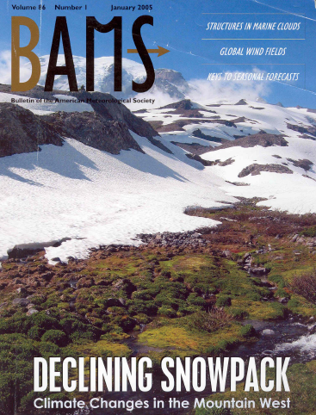
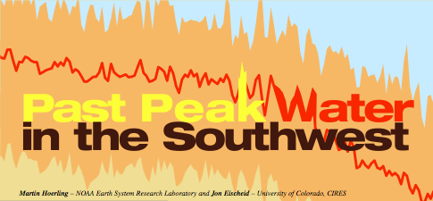
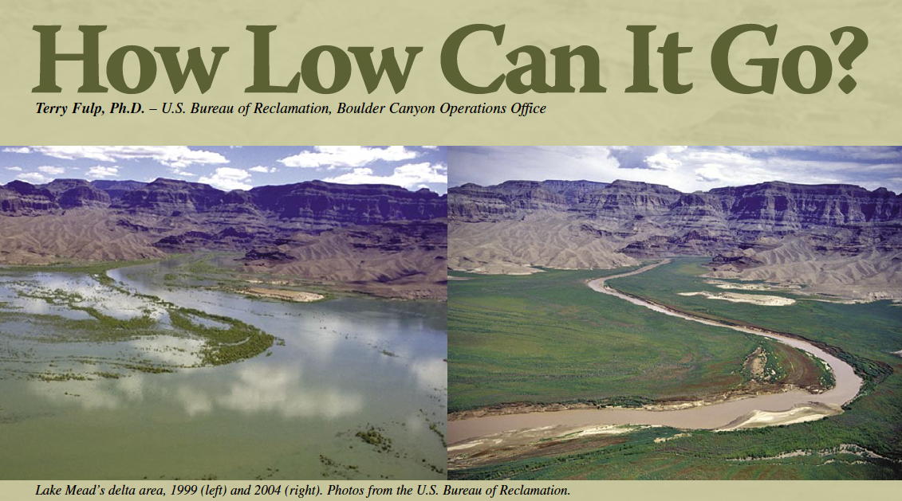
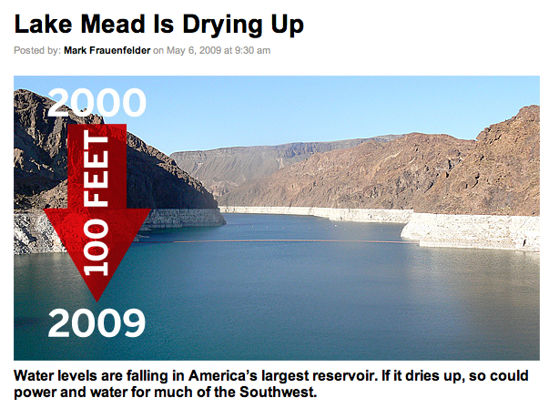
Motivation

Slide 35
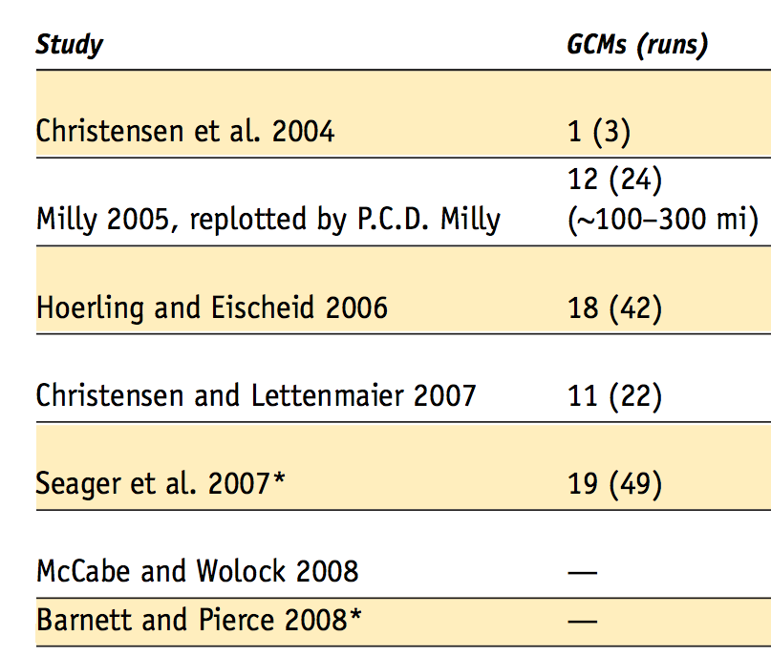
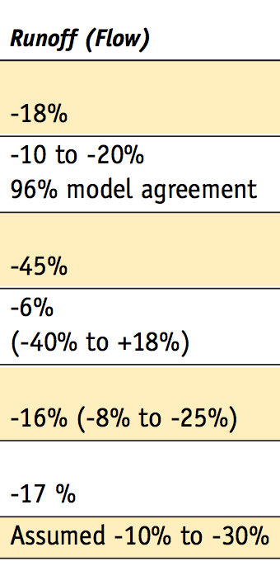
Past Studies of Future Runoff at Lees Ferry
Runoff (Mid-21st Century)
Information from Table 5-1 in Western Water Assessment (WWA) report for Colorado Water Conservation Board “Colorado Climate Change: A Synthesis to Support Water Resource Management and Adaptation.” Oct 2008 (available online at: http://cwcb.state.co.us/NR/rdonlyres/8118BBDB-4E54-4189-A354-3885EEF778A8/0/CCSection5.pdf)

Slide 36
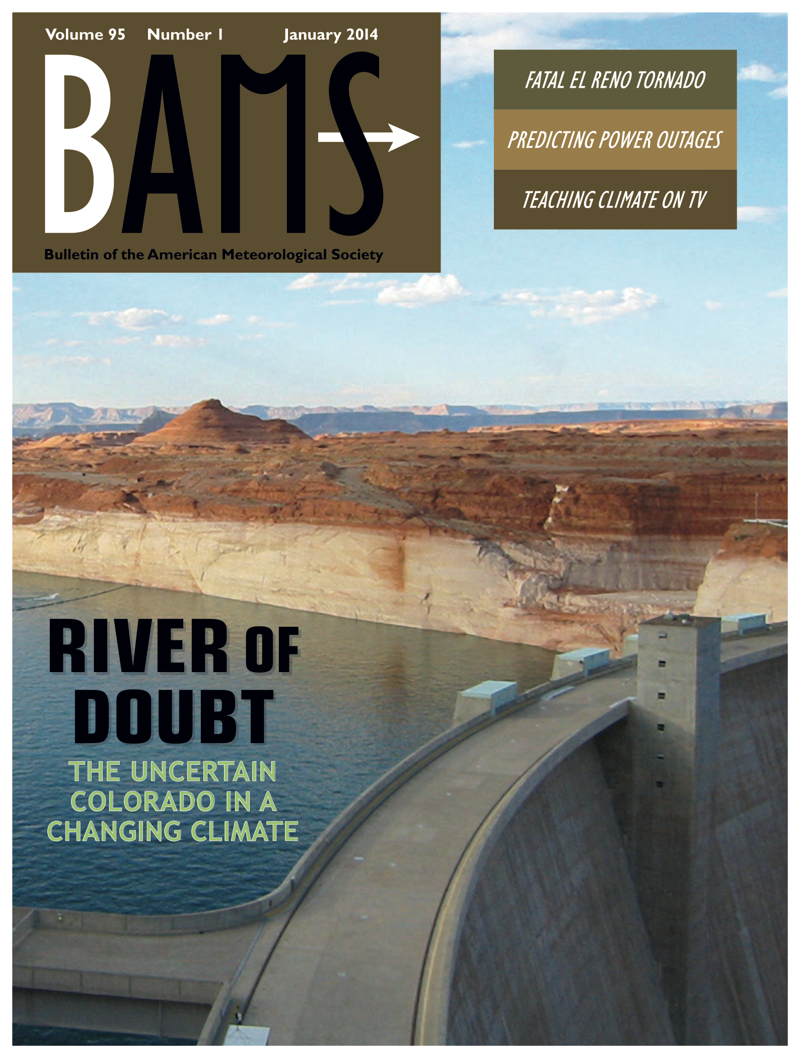










Notes:
The result of this effort is our paper -- One of the most impressive components of this paper is the list of co-authors who worked together to make a cohesive synthesis – from academia and federal agencies, people who are real leaders in the field and who were authors of the various papers with widely contrasting results.
Those not included in author list, were reviewers

Slide 37
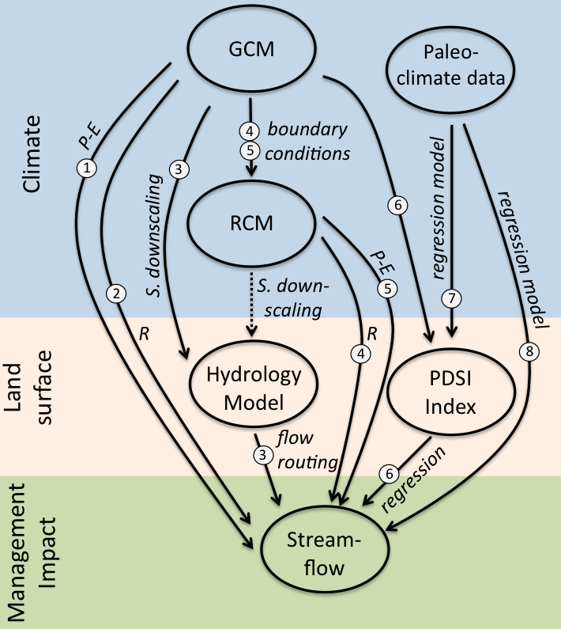
Approaches to generating future streamflow projections
Studies using various approaches:
Seager et al. 2007; Seager et al. 2013
Milly et al. 2005
Christensen et al. 2004; Christensen and Lettenmaier, 2007; Cayan et al. 2010; USBR 2011
Gao et al. 2011; Rasmussen et al. 2011
Gao et al. 2012
Hoerling and Eischeid 2007
Cook et al. 2004
Woodhouse et al. 2006; McCabe and Wolock 2007; Meko et al. 2007; USBR 2011
Abbreviations:
GCM – Global Climate Model
RCM – Regional Climate Model
PDSI – Palmer Drought Severity Index
P – Precipitation
T – Temperature
R – Runoff
E – Evaporation
S. downscaling – statistical downscaling
GCMs, Emission scenarios,
Spatial resolution,
Land surface representation
Figure from Vano et al., BAMS, January 2014
Notes:
Here is a schematic of how all these studies are related to each other in the type of methods they used. The studies also used different global climate models, emission scenarios, applied them at different spatial resolution along with the different representations of the land surface.
Make note of GMC and Paleoclimate data

Slide 38
Why is there such a wide range of projections of impacts of future climate change on Colorado River streamflow, and how should this uncertainty be interpreted?

Slide 39

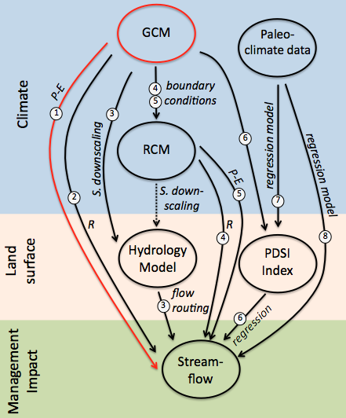
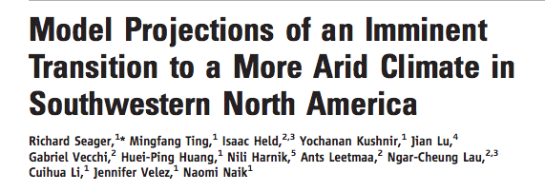
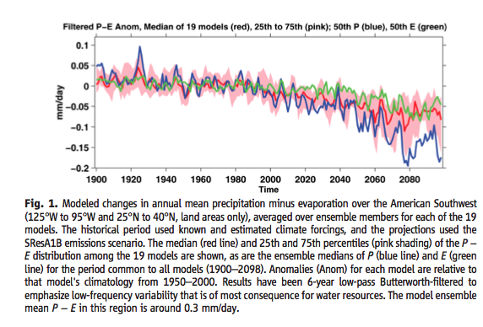
GCMs: 19
Emission scenarios: A1B
Spatial resolution: 2° (~200 km)
Land surface: GCM (P-E)
estimate:
-16% (-8 to -25%)
Notes:
Total Projections: 49 (multiple runs)

Slide 40
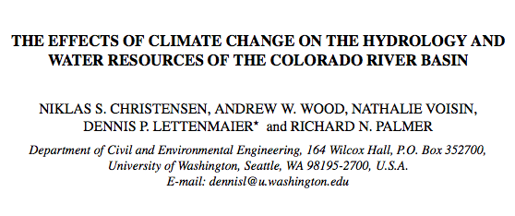
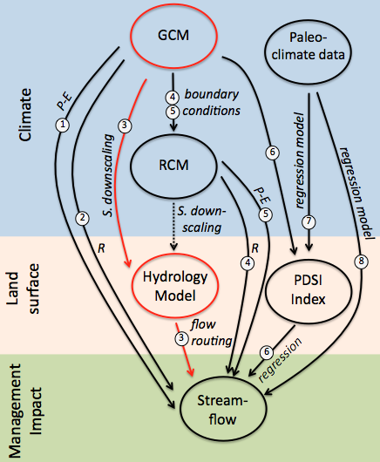

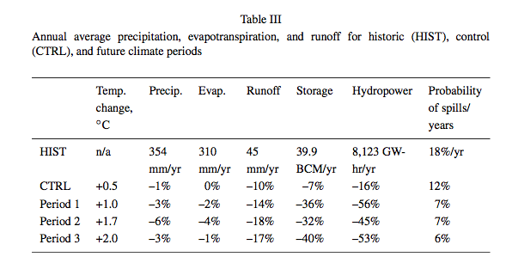
GCMs: 1 (PCM)
Emission scenarios: BAU
Spatial resolution: 1/8° (~12 km)
Land surface: Hydrologic model (VIC)
estimate:
-18%
Notes:
An earlier study…
Total Projections: 3 (multiple runs)

Slide 41
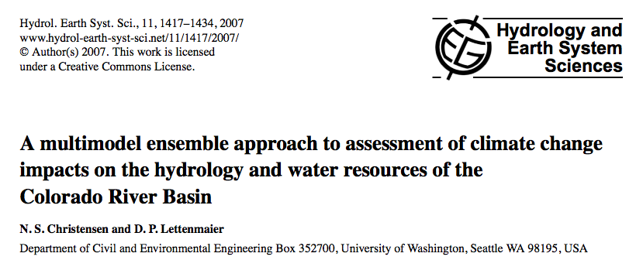
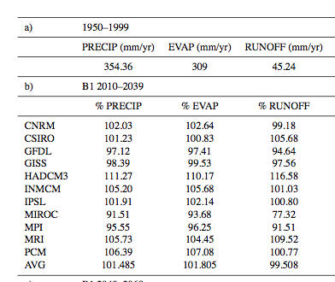
GCMs: 11
Emission scenarios: A2, B1
Spatial resolution: 1/8° (~12 km)
Land surface: Hydrologic model (VIC)
estimate:
-6% (-40 to +18%)
Notes:
Total Projections: 22

Slide 42
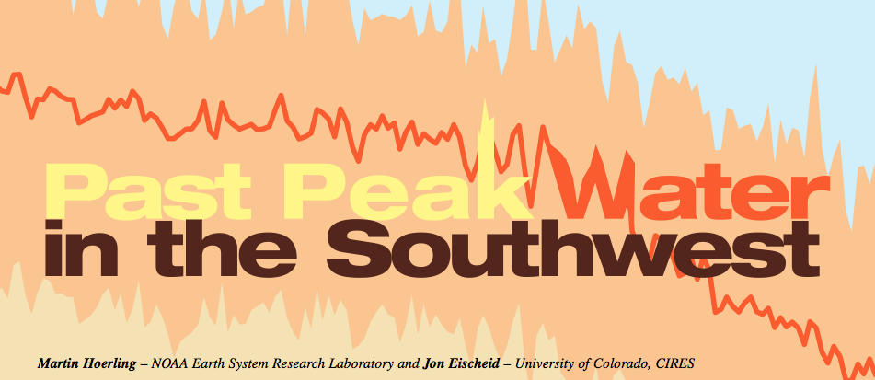
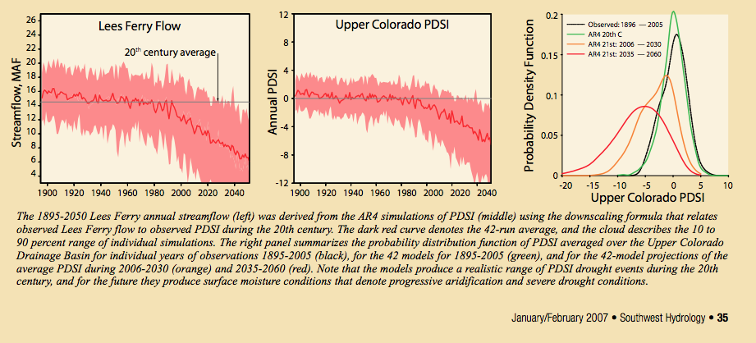
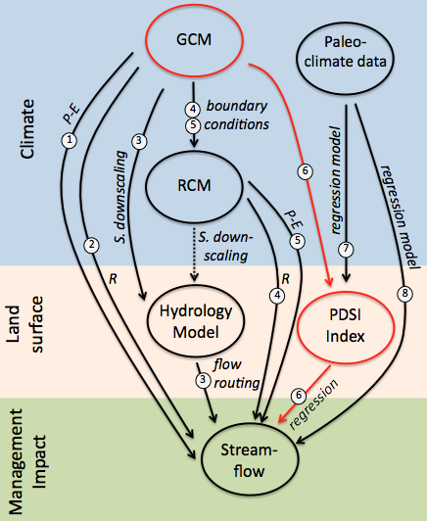
GCMs: 18
Emission scenarios: A1B
Spatial resolution: climate divisions (~150 km)
Land surface: Palmer Drought Severity Index with regression
estimate:
-45%
Notes:
Total Projections: 42 (multiple runs)

Slide 43
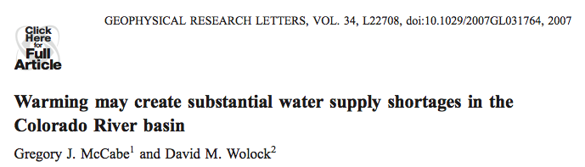
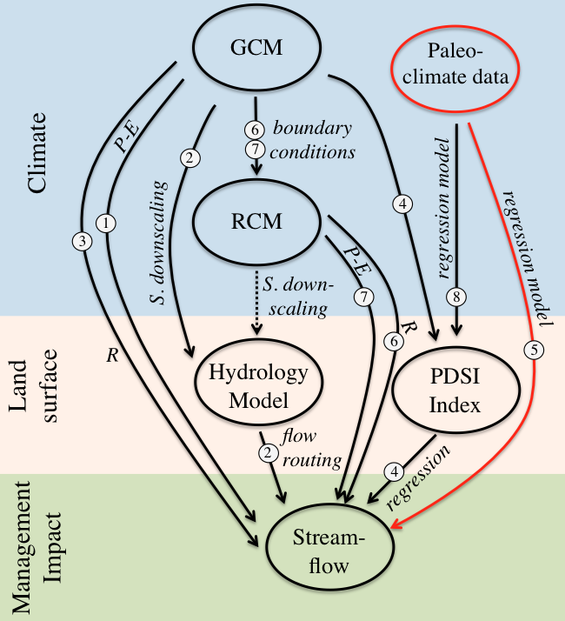
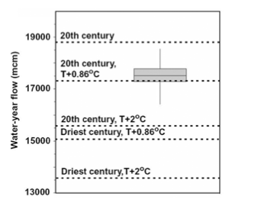
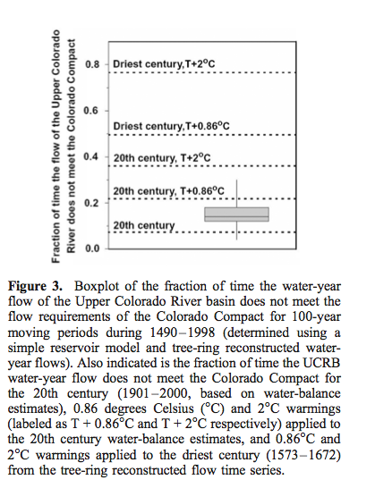
GCMs: estimated 2°C from GCMs and 0.86°C from current trend
Emission scenarios: NA
Total Projections: 2
Time period: 1490-1998
Spatial resolution: 62 HUC8s
Land surface: percent adjustment based on simple water balance model
Figure 2. Boxplot of mean water-year flow (mcm) for the Upper Colorado River basin for 100-year moving periods during 1490–1998 (determined using tree-ring reconstructed water-year flows). Also indicated are mean water-year UCRB flows for the 20th century (1901–2000, based on water-balance esti- mates), 0.86 degrees Celsius (°C) and 2°C warmings (labeled as T + 0.86°C and T + 2°C respectively) applied to the 20th century water-balance estimates, and 0.86oC and 2°C warmings applied to the driest century (1573–1672) from the tree-ring reconstructed flow time series.
estimate:
-17%
Notes:
The second approach was to apply the warming
scenarios to the driest century of reconstructed streamflow
in the tree-ring record. This can be viewed as a worst-case
scenario, in which a ‘‘naturally’’ very dry period is modified
consistent with the 0.86 and 2 C warming scenarios. It is
not possible to directly apply the warming scenarios to treering
reconstructed climate data because such climate data
for the UCRB do not exist. Instead, the reconstructed
streamflow values for the driest century in the tree-ring
record (1573–1672) were adjusted by average percentage
changes in estimated streamflow caused by the warming
scenarios applied to 20th century data. For example, the
0.86 C warming scenario applied directly to 20th century
climate caused an 8% decrease in streamflow (see next
section), so the reconstructed streamflow values were
decreased by 8% to represent a 0.86 C warming

Slide 44
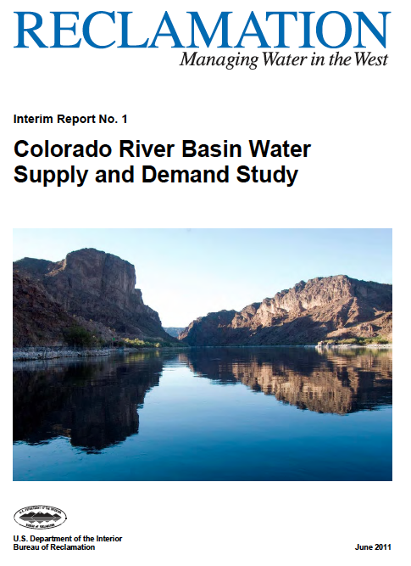
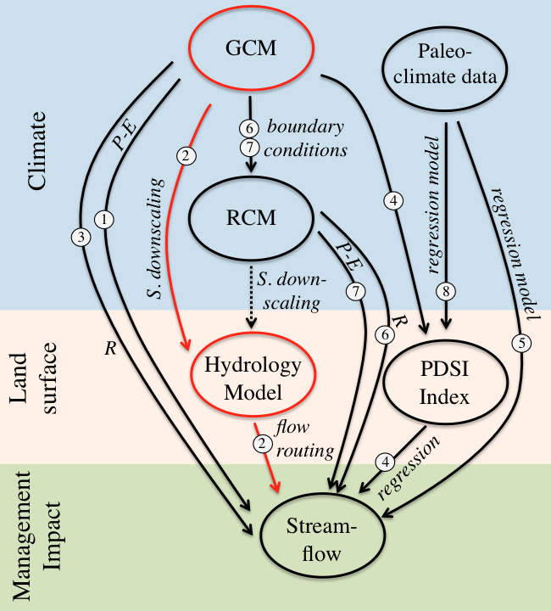
GCMs: 16
Emission scenarios: A2, A1B, B1
Total projections: 112 (multiple runs)
Time period: 1950-2099
Spatial resolution: 1/8° (~12 km)
Land surface: Hydrologic model (VIC)
estimate:
-15 to -20%

Slide 45
Sources of Uncertainty in Future Projections
Global Climate Model (GCM) and emission scenario selection
Spatial scale and topographic dependence of climate change projections
Land surface representations
Downscaling methods
Notes:
Through assessing the widely varying methods, we identified four explanatory factors to better understand how the uncertainty between these studies should be interpreted
Here are the four factors the are the sources of uncertainty in future projections. I’ll spend a little time talking about each of them…

Slide 46
1) Global Climate Model (GCM) and emission scenario selection
(a) Different GCMs, A1B scenario
Figure from Vano et al., BAMS, January 2014
Notes:
1st source of uncertainty… if you recall, different studies used different GCMs. Here we’ve made a comparison between the P-E anomalies in Seager et al that used 19 GCMs with C&L that used 11. THe bottom panel are the models used by Seager et al and not by C&L. As you can see in the red box, the models used by Seager and not by C&L are drier – therefore it makes sense that C&L had smaller flow declines

Slide 47
1) Global Climate Model (GCM) and emission scenario selection
(a) Different GCMs, A1B scenario
-19%
-13%
-24%
Figure from Vano et al., BAMS, January 2014

Slide 48
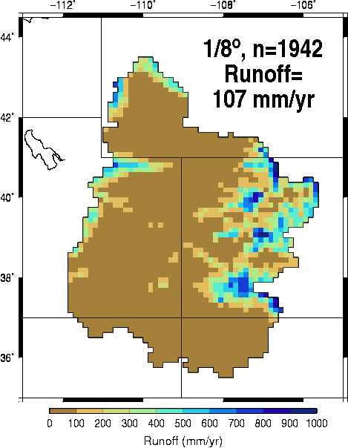
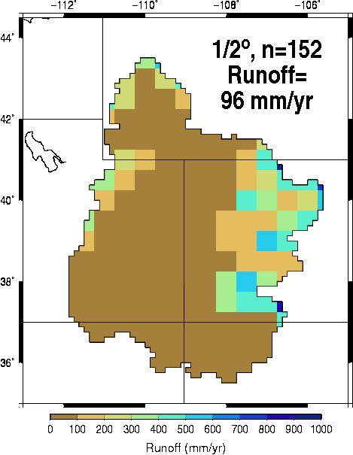
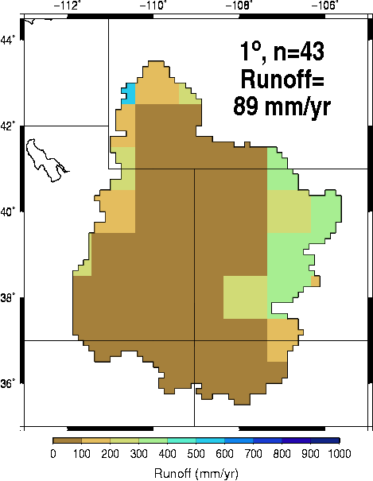
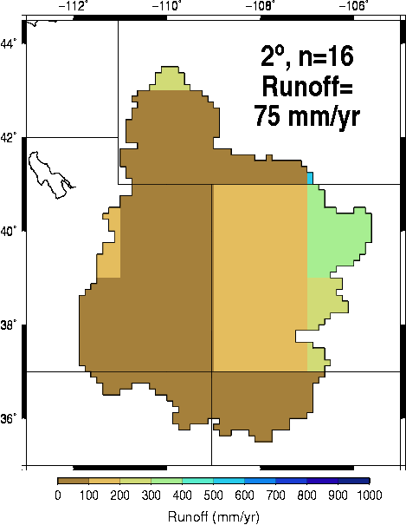
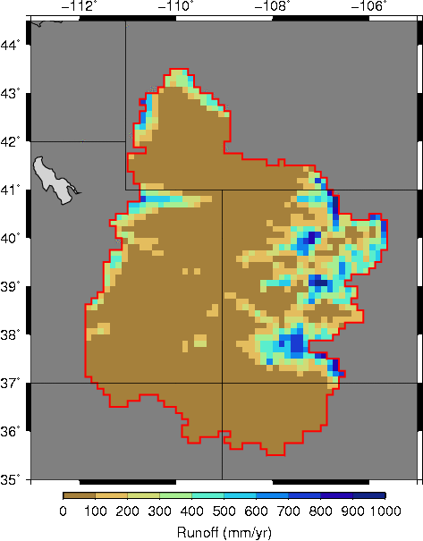
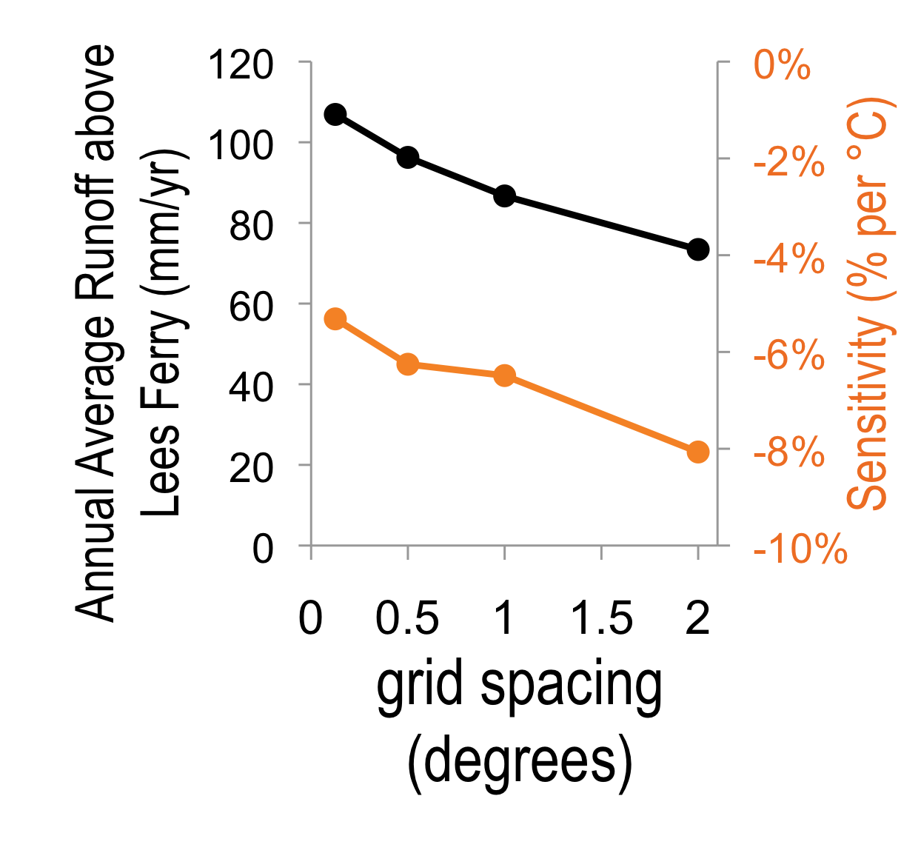
0 100 200 300 400 500 600 700 800 900 1000
Runoff (mm/year)
2) Spatial scale and topographic dependence of climate change projections
Figure from Vano et al., BAMS, January 2014
Notes:
The 2nd key source of uncertainty… spatial scale and topographic dependence (The models’ spatial resolution, which is important for capturing topography and its effect on the distribution of snow in the Colorado River’s mountainous headwaters.)
85% of flows from 15% area
To demonstrate this, we used a simple water balance model and ran it at different spatial resolutions using the same forcing data. As the line graph shows, as the grid sizes get larger, the runoff declines and sensitivity of the runoff to climate change gets more negative
Essentially, coarse spatial resolution does not resolve high elevation hydrologic processes that dominate basin runoff production

Slide 49
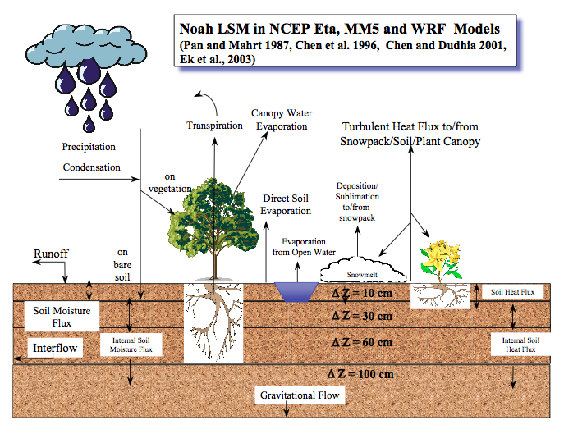

3) Land surface representations
Grid-based simulations of land-surface processes using principles of energy and water balance
Daily timesteps with some sub-daily processes
Forcing data: precipitation, temperature, specific humidity, wind speed, air pressure, and surface incident shortwave and longwave
Interested in those applied at regional to global scales
Diverse heritages and many more than those pictured above
Notes:
A 3rd source of uncertainty…
How land surface is represented. There are multiple ways that use principles of energy and water balance to simulate how water moves through the environment. How this is represented determines how precipitation and temperature changes will affect the land’s ability to absorb, evaporate or transport water, and thus affect simulated streamflow)

Slide 50
3) Land surface representations
Precipitation Elasticity
Temperature Sensitivity (%/°C)
CLM
CLM
Catchment
Noah 2.8
SAC op
Noah 2.7
SAC
TWB
Catchment
Noah 2.8
SAC op
VIC
Noah 2.7
SAC
TWB
VIC
Q _{ref+1%} - Q_{ref}
Q _{ref+0.1°C} - Q_{ref}
Precipitation
Elasticity
=
Temperature
Sensitivity
=
Q_{ref}
Q_{ref}
1%
0.1 °C
Figure from Vano et al., BAMS, January 2014
Notes:
We used hydrologic sensitivities as a way to distinguish how different representations respond to changes in precipitation and temperature. Looked at eight different models where we Essentially, we ran the model with historical weather forcing and then ran it again with a small perturbation in either T or P
Hydrologic sensitivities
For example,an elasticity of 3 means a, 5% decrease in precipitation, 15% decline in streamflow
there was considerable differences between models
***
Hydrologic sensitivities
For example, catchment elasticity of 3, 5% decrease in precipitation, 15% decline in streamflow, whereas with Noah 2.8 a 5% decline translates to a 11%

Slide 51
4) Downscaling methods
How do we translate global info into regional water management?
Figure courtesy of Climate Impacts Group
Notes:
The 4th source of uncertainty, how global information is translated into regional water management. In other words, the methods used to downscale from the roughly 200-kilometer resolution used by global climate models to the 10- to 20-kilometer resolution used by regional hydrology models)

Slide 52
4) Downscaling methods
Global Climate Models
(A2 emissions scenario)
Comparison of BCSD downscaling from Christensen and Lettenmaier (2007) with a delta method downscaling approach for Lees Ferry in the 2040-2069 future period for the A2 where, on average, the BCSD approach has a decline of 7% whereas with the delta method, declines are 13%.
Figure from Vano et al., BAMS, January 2014
Notes:
We evaluated two examples of downscaling, the delta method in light gray and bcsd in black and orange being the difference – we found for a2 emissions, the delta method had a 13% decline whereas the BCSD had an average 7% decline. So your choice in downscaling effects the overall results (although not as much as what GCM is used)
**
Two examples, although there are many new downscaling approaches being developed… see result in differences, but these differences are not as large as differences between GCMs.

Slide 53
Approaches to generating future streamflow projections
Studies using various approaches:
Seager et al. 2007; Seager et al. 2013
Milly et al. 2005
Christensen et al. 2004; Christensen and Lettenmaier, 2007; Cayan et al. 2010; USBR 2011
Gao et al. 2011; Rasmussen et al. 2011
Gao et al. 2012
Hoerling and Eischeid 2007
Cook et al. 2004
Woodhouse et al. 2006; McCabe and Wolock 2007; Meko et al. 2007; USBR 2011
Abbreviations:
GCM – Global Climate Model
RCM – Regional Climate Model
PDSI – Palmer Drought Severity Index
P – Precipitation
T – Temperature
R – Runoff
E – Evaporation
S. downscaling – statistical downscaling
GCMs, Emission scenarios,
Spatial resolution,
Land surface representation
Figure from Vano et al., BAMS, January 2014
Notes:
Make note of GMC and Paleoclimate data

Slide 54
Past records provide context
1922 Colorado R. compact
80% confidence
intervals
25-year running averages, instrumental record
25-year running averages, streamflow reconstruction
Allocated flows, 20.4 BCM (16.5 MAF)
Observed values from USBR
Figure from Vano et al., BAMS, January 2014; 1250-year streamflow construction data as reported by Meko et al. (GRL, 2007)
Notes:
In addition to the instrumental record, tree-ring reconstructions done in more recent years show evidence of much lower flows dating back over 1000 years, the early 20th century considerably wet
To really understand future streamflow, a comprehensive approach should include consideration of paleoclimate records as well as future projections. I showed these top two figures earlier – and the lower figure also reiterates the point that the past in the Colorado River basin was much drier
Likely, regardless of climate change, going to have values drier than the instrumental records – then too, add effects of climate change, get the real worst case scenario

Slide 55
Past records provide context
1922 Colorado R. compact
80% confidence
intervals
25-year running averages, instrumental record
25-year running averages, streamflow reconstruction
Allocated flows, 20.4 BCM (16.5 MAF)
Observed values from USBR
A comprehensive approach should include both paleoclimate reconstructions and future projections. Megadrought compounded by anthropogenic climate change represents a real ‘worst-case’ scenario.
Figure from Vano et al., BAMS, January 2014; 1250-year streamflow construction data as reported by Meko et al. (GRL, 2007)
Notes:
Lesson 5: To understand future streamflow and subsequent uncertainties, a comprehensive approach should be taken, including analyses of paleoclimate reconstructions as well as future projections. Together these two lines of discovery can be used to explore the basin’s response to megadrought-like reductions in precipitation compounded by anthropogenic climate change, the real ‘worst-case’ scenario.

Slide 56
Planning and management implications
Dichotomy
Climate science advances by using different approaches not easily reconciled
Planner prefer explicit characterizations of uncertainties that can be directly incorporated into risk-based calculations
Calls for actionable science that provides data, analyses, projections, or tools that can support decisions regarding management of risks and impacts of climate change (from scientists) AND management decision approaches that accommodate uncertainty (from managers/planners)
Notes:
In this work, we became very aware of the dichotomy – science advances by using different approaches, getting results that may differ and deciding how to move forward – whereas planners prefer explict characterizations…
Therefore, moving ahead calls for scientists to generate actionable science that is …
***
Lesson 6: The water/climate research and water management communities need to work more closely to generate the actionable science needed for planning and other decision making. Collaboration is particularly important under non-stationary conditions in order to develop and update information that allow management tools to represent the various sources of uncertainty. It is crucial that the management community seek decision approaches that accommodate uncertainty, complex systems, and ambiguity of model evidence, such as strategic scenario planning.
From draft report of the Advisory Committee on Climate Change and Natural Resource Science to Secy of the Interior. Definition of Actionable Science: Actionable science provides data, analyses, projections, or tools that can support decisions regarding management of the risks and impacts of climate change. It is ideally co-produced by scientists and decision-makers and creates rigorous and accessible products to meet the needs of stakeholders.

Slide 57
Interpretation for Decision Makers
From past AR4 studies, we can say with high likelihood that in the Colorado:
Temperatures (T) will rise over the coming decades
Precipitation (P) less certain, but will likely decline annually
T and P responses depend on intensity of greenhouse gas emissions
Warmer T (ignoring P) will reduce runoff production (our estimates -6.5 ±3.5% per °C at Lees Ferry)
Change in P results in streamflow response of 2 to 3 times (5% decline in P results in 10-15% decline in streamflow)
Coarse spatial resolution does not resolve high elevation hydrologic processes that dominate basin runoff production
Natural variability in paleoclimate reconstructions show prolonged multi-decadal dry periods. Going to see decades of sustained streamflow much lower than observed in ~100 years instrumental record (especially with climate change exacerbation)
Paper at http://doi.org/10.1175/BAMS-D-12-00228.1
Notes:
want to highlight that from this evaluation, were able to agree on several key points with certainty that would be of interest to decision-makers
--Temperatures will rise in the Colorado River basin over the coming decades, as indicated by all GCMs, for all emission scenarios.
--As indicated by most GCM projections for the Colorado River basin (more so than for most of the conterminous United States), precipitation will decline on an annual basis, notwithstanding a wide range in the projected magnitude of reductions (and a minority of GCMs that project increases).
--The magnitude of temperature and precipitation response depends on the intensity of future human greenhouse gas emissions, with larger emissions resulting in larger increases in temperature and a greater likelihood of precipitation declines. Current estimates project increases of 2.5±1°C with -4±12% changes in precipitation for high emissions scenarios and 2±1°C with -2.5±6% changes in precipitation for low emission scenarios by the mid-21st century (Cayan et al. 2012).
--Warmer temperatures alone (ignoring possible changes in precipitation) will reduce annual runoff production in the Colorado River basin. For example, our evaluation of multiple hydrological models estimate streamflow declines of -6.5±3.5% per °C at Lees Ferry. If we apply this to estimations of mid-21st century warming of +2.5±1°C, we estimate a future streamflow change that ranges approximately from -5% to -35%.
--The ratio of annual runoff change to annual precipitation change (precipitation elasticity) at Lees Ferry is between 2 to 3, based on our evaluation of multiple hydrological models and observations. This means that a 5% decline in precipitation will likely result in a 10-15% decline in streamflow, in addition to the temperature driven declines.
The coarse spatial resolutions of current state-of-the-art GCMs and even RCMs do not resolve the scales of high elevation hydrologic processes that dominate runoff production in the Colorado River Basin.
Natural variability in paleoclimate reconstructions clearly indicate there have been prolonged multi-decadal dry periods (megadroughts). This type of drought, exacerbated by a steady reduction in flows due to ongoing climate change, would result in decades of sustained streamflows much lower than have been observed in ~100 years of instrumental record.

Slide 58


Successes and Lessons
14 co-authors, from academia and federal agencies, many authors of divergent papers
Reached agreement on four key sources of future uncertainties AND important certainties
Documented how to approach seemingly disparate results
Download at: http://doi.org/10.1175/BAMS-D-12-00228.1
As science evolves, understandings will improve. However, there will be no single magic bullet. Therefore, a continued effort to communicate and incorporate uncertainty is needed.
Notes:
particularly timely with new results being released with the 5th Assessment Report (AR5)
Reported to White House Subcommittee on Water Availability and Quality
Study picked up by several news agencies
In summary,
The paper, with it’s 14 co-authors from academia and federal agencies, reached agreement on key sources of uncertainty and important certainties
This provides information for the larger science and management communities on how to approach seemingly disparate results. If you remember back to the table of the range of results, with this study we can evaluate the studies, for instance the lowest change value 6% (c&l) is affected by the selection of gcm and downscaling approach, while the largest value (hoerling) 45% does not capturing the headwaters with there larger spatial resolution .
This will be particularly important with all the new studies that are likely to come out – the results we evaluated here where primarily from AR4.
Also, the process helped foster novel research that can help us to better identify how we think about future changes

Slide 59
More recent findings

Slide 60




Slide 61

Between 2000 and 2014, annual Colorado River flows averaged 19% below the 1906–1999 average, the worst 15-year drought on record. At least one-sixth to one-half (average at one-third) of this loss is due to unprecedented temperatures (0.98C above the 1906–1999 average), confirming model-based analysis that continued warming will likely further reduce flows.

Slide 62

… recent droughts have been ampliﬁed by
warmer temperatures that exacerbate the effects of relatively modest precipitation deﬁcits. Since 1988, a marked increase in the frequency of warm years with lower ﬂows than expected, given precipitation,
suggests continued warming temperatures will be an increasingly important inﬂuence in reducing future UCRB water supplies.

Slide 63

This new record indicates that the recently observed trends in runoff ratio are unprecedented in the 445 year record. Together with precipitation, high temperatures have an important influence, making very low runoff ratios 2.5–3 times more likely.

Slide 64
Ongoing research

Slide 65




























Working to improve the utility of tools to support water resource planning and management
Notes:
1 National Center for Atmospheric Research
2 University of Washington
3 U.S. Army Corps of Engineers
4 Bureau of Reclamation
and many collaborators (e.g., people in Civil and Env. Engineering at the University of Washington)…

Slide 66
Modeling tools and datasets for evaluating past events, monitoring current conditions, predicting conditions hours to seasons in advance, and providing possible projections of changes in future years and centuries to support water resource management and planning.
Current generation
Next generation
Observations,
climate models
Obs. ensembles,
climate info. &
climate models
Research areas:
meteorological forcings
downscaling
hydrologic modeling
streamflow forecasting (e.g., SHARP)
climate projections (e.g., hydrologic storylines)
GMET
downscaling
ICAR+
downscaling
(statistical re-scaling, limited dynamical)
(+ large ensemble quasi-dynamical, circulation-based statistical)
Hydrology Model
(single model,
single parameterization)
SUMMA
Flexible hydrology
modeling and
forecasting frameworks
MPR-flex
Data Assimilation
stream routing
mizuRoute
stream routing
(grid-based)
(spatially variable)
Impact
Impact &
adaptation

Slide 67

1. Meteorological forcings
An ensemble of observational datasets
The challenge:
Only a single representation of gridded observations is used.
Facing the challenge:
Gridded Meteorological Ensemble Technique (GMET) generates probabilistic gridded dataset that reflect observational uncertainty, 100-member dataset available for CONUS, Alaska and Hawaii under development.
More at: https://ncar.github.io/hydrology/models/GMET
Figure. Gridded precipitation ensemble mean (top) and standard deviation (bottom) during the Mississippi River flood of 1993.
Notes:
a tool that generates high-quality, probabilistic gridded meteorological fields for use in climate model evaluation, hydrologic modeling, and hydrologic data assimilation
ABSTRACT (Andy Newmans): Gridded precipitation and temperature products are inherently uncertain due to myriad factors. These include interpolation from a sparse observation network, measurement representativeness, and measurement errors. Despite this inherent uncertainty, uncertainty is typically not included, or is a specific addition to each dataset without much general applicability across different datasets. A lack of quantitative uncertainty estimates for hydrometeorological forcing fields limits their utility to support land surface and hydrologic modeling techniques such as data assimilation, probabilistic forecasting and verification. These issues are acutely relevant in Alaska and Hawai’i, where extreme spatial gradients are present along with sometimes very sparse observation networks, and even daily deterministic precipitation and temperature products are nearly nonexistent. To address this critical data gap, we have modified a recently developed methodology to produce the first observation-based gridded, daily, ensemble precipitation and temperature estimates for Alaska and Hawai’i.
Previously we used localized spatial regression including topography to create a gridded product with topographic effects. In this case, due to the intense spatial gradients and insufficient station density, we use localized spatial regression of daily normal ratios for precipitation and temperature anomalies and apply monthly climate fields to enforce long-term climatological and topographic spatial patterns. We will present initial results on these new high resolution products (2 km for Alaska and 250 m for Hawai’i), and discuss plans to improve the datasets, focusing on efforts to fuse the sparse station data with high resolution numerical weather prediction model output.

Slide 68

2. Downscaling
Locally relevant climate information
The challenge:
Downscaling is either high-resolution regional climate models (capture local atmospheric dynamics) or statistical methods (computationally efficient).
Facing the challenge:
Intermediate Complexity Atmospheric Research model (ICAR) provides a way of generating local climate information that captures local atmospheric dynamics AND is computationally efficient.
More at:
https://ncar.github.io/hydrology/models/ICAR
Figure. Precipitation totals [mm] simulated by (a) WRF, (b) ICAR, and estimated by (c) PRISM for the winter of 2000-2001.
Notes:
ICAR explains 85-95% of the variability represented in a much more complex regional climate model; performed 100 to 1000 times faster.
ICAR combines large-scale atmospheric circulation from climate models with Linear Mountain Wave theory, a mathematical solution for determining the effect of mountains on atmospheric winds, to generate wind fields and calculate the motion of air parcels within the atmosphere. Then ICAR performs detailed full-physics calculations relating three-dimensional water vapor and temperature to the formation of clouds, rain, and snow. The resulting precipitation predictions are similar to those predicted by a full-complexity regional climate model (WRF), and to the PRISM observed dataset (illustrated in the figure above).
ABSTRACT (Ethan’s) Climate downscaling is an inherently uncertain process. Despite this, many applications of climate data use a single downscaling method to determine locally important effects. There exist a large number of different downscaling methods, spread across a continuum of general approaches, which range from simple statistical bias corrections to extremely complex regional climate models. Here we examine a range of methods across a variety of climate projections to begin to understand the relative importance of the choice of downscaling method compared to the choice of climate model, emissions scenario, or chaotic variability. We include some of the simpler statistical rescaling methods (BCSD and Asynchronous Regression), a more sophisticated analog regression model conditioned on atmospheric circulation, a quasi‐dynamical downscaling model (The Intermediate Complexity Atmospheric Research model ICAR), and finally a fully non-hydrostatic regional climate model (WRF) run on convection permitting (4km) and convection parameterized (20 km) grids. These downscaling methods are applied over two major river basins to different climate models and different ensemble members of the same model, with the exception of the high-resolution WRF setup, which is too computationally expensive to apply to more than a few climate projections. We diagnose the sensitivity to method choice of the mean change in precipitation and temperature, as well as the seasonality and physical interpretation (e.g. elevation dependent warming, and changes in orographic precipitation) of that change. We further test sensitivity of the change signal in ICAR to model physics choice (e.g. microphysics parameterizations and parameters), and the sensitivity of the analog-regression downscaling model to individual modeling decisions such as the number and weighting of analogs, or mathematical transformations used. These downscaling method sensitivities are then put in the context of the uncertainty expected from different climate models and chaotic internal variability. While the difference between any two climate projections is greater than the difference between different downscaling methods, when averaged across a larger number of projections, the uncertainty due to downscaling method can be greater than the standard error of the mean change signal.
ABSTRACT Trude’s: To produce hydrological projections of change due to anthropogenic climate change, downscaling of climate models is necessary to provide information on relevant spatial and temporal scales. Here we present 12 km downscaled projected precipitation over the Contiguous United States (CONUS) from 10 CMIP5 models (Coupled Model Intercomparison Project Phase 5) for RCP4.5 and RCP8.5 from the years 2006-2100. In addition, we downscaled the historical runs (1950-2006) of the same CMIP5 models. We employed a quasi-dynamical downscaling approach using the Intermediate Complexity Atmospheric Research (ICAR) model. This model uses a complex linear model to describe the perturbations to the wind field caused by topography, and includes detailed physical schemes for advection, microphysics, and land surface modeling. For input to the ICAR downscaling, the CMIP5 runs were first bias corrected against ERA-I reanalysis (1980-2005), then downscaled by WRF to a 50 km grid resolution to provide hourly input to ICAR. The ICAR CONUS simulations (using ERA-I as input) are compared with gridded observational datasets. We evaluate the downscaled CMIP5 results based on the historical runs, and then assess the variability in the projected precipitation between the different downscaled CMIP5 models from the ~100 year future downscaled ICAR results. Finally, the downscaled ICAR results are compared with other statistically downscaled datasets, such as the Bias Corrected Statistical Disaggregation (BCSD) climate projection, and a hybrid analog-regression statistical downscaling technique based on the WRF-50 km simulations.

Slide 69

3. Hydrologic modeling
Better characterized hydrologic risk and uncertainty
The challenge:
Only a single hydrologic model representation is used.
Facing the challenge:
The SUMMA framework can systematically characterize hydrologic model uncertainty through exploring modeling decisions with controlled manipulations of model configurations and parameters.
More at:
https://ncar.github.io/hydrology/models/SUMMA
Figure. SUMMA (Structure for Unifying Multiple Modeling Alternatives) framework illustrates how SUMMA supports multiple options for a range of physical processes integrated with a common numerical solver, see Clark et al. (WWR, 2015a,b) for details.
Notes:
ABSTRACT (Martyn’s)
Most land models have a convoluted heritage. Model enhancements are often incorporated in a rather ad-hoc fashion with limited attention given to process coupling, numerical error control, systematic tests, and model extensibility and flexibility. As a result, it can be very difficult to robustly incorporate new modeling approaches and evaluate competing modeling alternatives.
This presentation summarizes experiments with the Structure for Unifying Multiple Modeling Alternatives (SUMMA) to evaluate alternative methods for constructing land models. Specifically we introduce a fully-coupled solution for the hydrologic and thermodynamic state equations (with numerical error control and adaptive substepping), and compare the fully coupled solution with the uncontrolled and ad-hoc operator splitting and asynchronous coupling methods that are typically employed in the current generation of land models. We also introduce and compare several strategies for model speedup. We demonstrate that the current generation of land models is contaminated by troublesome numerical artifacts that complicate model analysis, especially parameter estimation and hypothesis testing. Further, we demonstrate that clear separation of the physical process parameterizations from the numerical solution methods, and adopting robust global solvers, substantially increase model flexibility and extensibility. We will end the presentation with a discussion on ways to improve the construction of land models, in order to simplify sharing of code and concepts across model development groups and accelerate land model development.

Slide 70

4. Streamflow forecasting
SHARP, System for Hydromet Research Analysis and Prediction, provides a framework for automated over-the-loop streamflow predictions to allow for public demonstration and testing of the performance of new techniques.
More at: https://www.ral.ucar.edu/projects/sharp
Notes:
Build capacity to adapt to climate impacts on hydrology
The challenge: current practice for seasonal streamflow forecasts are not reproducible and cannot quantify uncertainties
Facing the challenge: develop a fully automated hydrologic modeling and applications system to evaluate whether new science-based techniques and workflows for real-time hydrologic monitoring and prediction are viable for seasonal streamflow forecasting
ABSTRACT Many if not most national operational short-to-medium range streamflow prediction systems rely on a forecaster-in-the-loop approach in which some parts of the forecast workflow are automated, but others require the hands-on-effort of an experienced human forecaster. This approach evolved out of the need to correct for deficiencies in the models and datasets that were available for forecasting, and often leads to skillful predictions despite the use of relatively simple, conceptual models. On the other hand, the process is not reproducible, which limits opportunities to assess and incorporate process variations, and the effort required to make forecasts in this way is an obstacle to expanding forecast services – e.g., though adding new forecast locations or more frequent forecast updates, running more complex models, or producing forecast ensembles and hindcasts that can support verification. In the last decade, the hydrologic forecasting community has begun develop more centralized, ‘over-the-loop’ systems. The quality of these new forecast products will depend on their ability to leverage research in areas including earth system modeling, parameter estimation, data assimilation, statistical post-processing, weather and climate prediction, verification, and uncertainty estimation through the use of ensembles.
Currently, the operational streamflow forecasting and water management communities have little experience with the strengths and weaknesses of over-the-loop approaches, even as the systems are being rolled out in major operational forecasting centers. There is thus a need both to evaluate these forecasting advances and to demonstrate their potential in a public arena, raising awareness in forecast user communities and development programs alike. To address this need, the National Center for Atmospheric Research is collaborating with the University of Washington, the Bureau of Reclamation and the US Army Corps of Engineers, using the NCAR ‘System for Hydromet Analysis Research and Prediction Applications’ (SHARP) to implement, assess and demonstrate real-time over-the-loop forecasts. We present early hindcast and verification results from SHARP for short to medium range streamflow forecasts in a number of US case study watersheds.

Slide 71

5. Storylines demonstration project
Explicitly estimate dominant sources of uncertainty in order to characterize the range of outcomes
Reduce uncertainties
Sample from the range to construct quantitative hydrologic storylines useful for water resources planning
Notes:
EMBRACING UNCERTAINTY
Consider model diversity, model fidelity, and model sensitivity.
Are there ways to understand climate change impacts that are less computationally involved and focus on the impact you care most about?

Slide 72
5. Storylines demonstration project
Demonstration Project
(provisional data*)
2 x 40
10 x 8
1 x 80
2 x 40
1 x 80
2 x 40
80
% change annual flow
*Provisional data provided by the UW Hydro | Computational Hydrology Group at the University of Washington

Slide 73
5. Storylines demonstration project
Libby Reservoir, 2030-2079 relative to 1950-1999
Provisional data provided by the UW Hydro | Computational Hydrology Group at the University of Washington
% change annual flow
% change annual flow
Notes:
The short explanation is the bars are averages across each method. Each plot has all 80 runs, just averaged differently - e.g., the two RCP bars are averages of 40 simulations. The figure on the right is the distributions of those groupings.

Slide 74

https://ral.ucar.edu/hap/computational-hydrology
Designed to make research more accessible in layers, particularly for USACE and Bureau partners

Slide 75
Concise summaries of tools, each include:
The challenge
How this tool faces this challenge
What are the scientific advances
What are the directions forward
Where one could go for more information

Slide 76
Extra slides

Slide 77









Precipitation Elasticities
percent change in flow per percent increase in precipitation
Q _{ref+1%} - Q_{ref}
P
elasticity
=
Q_{ref}
1%
count
VIC
CLM
Catchment
Noah 2.7
Noah 2.8
Sac
Notes:
Remember to explain what histogram is showing (x axis, y axis)

Slide 78







Precipitation Elasticities
percent change in flow per percent increase in precipitation
Q _{ref+1%} - Q_{ref}
P
elasticity
=
Q_{ref}
1%
count
VIC
CLM
Catchment
Noah 2.7
Noah 2.8
Sac
Notes:
Remember to explain what histogram is showing (x axis, y axis)

Slide 79







Temperature Sensitivity
percent change in flow per °C temp increase
T
Sensitivity
(Tmin&Tmax)
Q _{ref+0.1} - Q_{ref}
=
Q_{ref}
0.1 °C
count
VIC
CLM
Catchment
Noah 2.7
Noah 2.8
Sac

Slide 80






Temperature Sensitivity
percent change in flow per °C temp increase
T
Sensitivity
(Tmin&Tmax)
Q _{ref+0.1} - Q_{ref}
=
Q_{ref}
0.1 °C
count
VIC
CLM
Catchment
Noah 2.7
Noah 2.8
Sac

Slide 81

Bias Correction and Downscaling
bias-corrected climate scenario
from NCDC observations
month m
month m
raw climate scenario
from PCM historical run
For future climate runs, temperature trend (relative to observed run) removed before, and replaced after, bias correction step
Slide courtesy of Niklas Christensen, MS Defense

Slide 82
Information sharing and
two-way learning

Slide 83




What do bridges between research and applications look like?
Usable products
Assessable information about those products
Appropriate guidance
Engaged practitioners
Effective feedback
Modeling tools, datasets +
Accessible information: factsheets, website
Guidance for using climate information in water resources planning
Why?
A single realization does not capture the three overarching uncertainties: (1) Human contributions to greenhouse gases and aerosols, (2) Ability to capture physical processes using models and how realistically they respond to changes in forcings, (3) Natural variability of systems.
Path forward
Use multi-model ensembles (MME), or in some cases perturbed physics ensembles (PPE). More realizations provide a better representation of possible futures. That said, more global climate model selected randomly is not necessarily better. Instead, identify models that span the range of possible futures for the impact of interest.
Frequently asked questions
How many climate projections should I use?
It depends on your risk tolerance…
When should I use multi-model averages v. individual models?
Use averages only when the impact is an average (e.g., shifts in seasonal hydrographs), use individual models for time series dependent impacts (e.g., floods)….
Real world examples...

Slide 84

0.1

Slide 85



Comparing emission scenarios
from Climate Change in Colorado, 2014 report by WWA
Notes:
From Climate Change in Colorado
A Synthesis to Support Water Resources Management and Adaptation

Slide 86

Why believe climate models?
from Climate Change in Colorado, 2014 report by WWA

Slide 87


Why believe climate models?
from Climate Change in Colorado, 2014 report by WWA

Slide 88

Why believe climate models?
from Climate Change in Colorado, 2014 report by WWA

Slide 89

RCP 4.5
from Climate Change in Colorado, 2014 report by WWA

Slide 90

from Climate Change in Colorado, 2014 report by WWA

Slide 91


from Climate Change in Colorado, 2014 report by WWA

Slide 92


from Climate Change in Colorado, 2014 report by WWA

